Slide 1
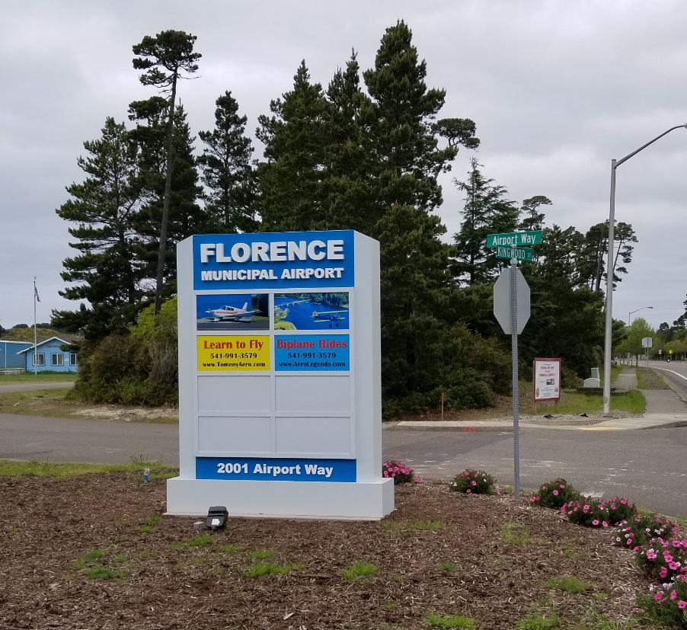
Florence
Airport
Overview
Florence Transportation Committee
13 May 2021
Terry E. Tomeny
Larry Farnsworth

Slide 2
Purpose
Florence Municipal Airport Overview
Review Airport Activities
Airport Goals
Airport SubCommittee Ideas

Slide 3
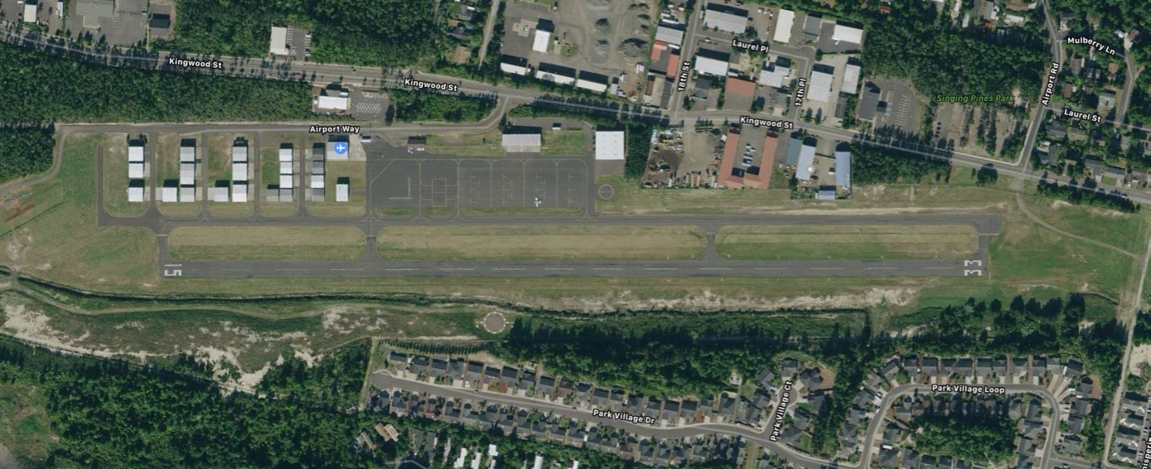
Florence Municipal Airport
3000’ x 60’ Asphalt
26 Hangars
Airport Office
Volunteer Group
Automated Weather
Loaner Car
Avgas & Jet Fuel
Runway Lighting

Slide 4
Former
Airport Advisory Committee
(AAC)
Advisory committee to City Council and City Manager
Implementation of Airport Master Plan
Operation of Airport
Currently Seven Members
  Terry Tomeny – Chair
  Dick Markee – Vice Chair
  Sam Spayd
  Jim Lamonica
  George Henry
  Larry Farnsworth
  Richard Holcombe
Staff
  Mike Miller
  Andy Parks
  Mark Durbin
  Larry Jensen

Slide 5
Airport Goals
  Safe Flight Operations
  Bring in Tourism
  Business Development
  Support Activities
    Wings & Wheels
  Airport Upgrades

Slide 6
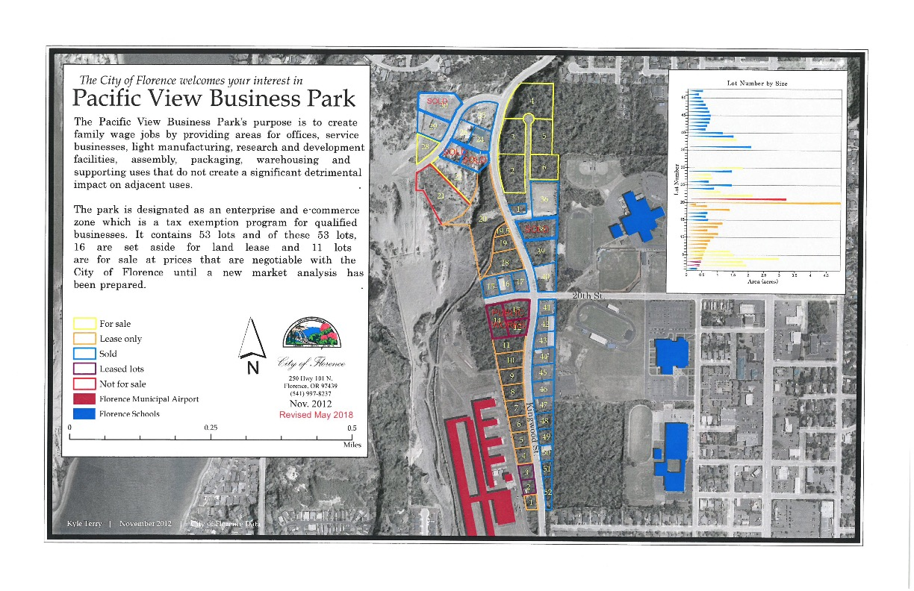
Pacific View Industrial Park

Slide 7
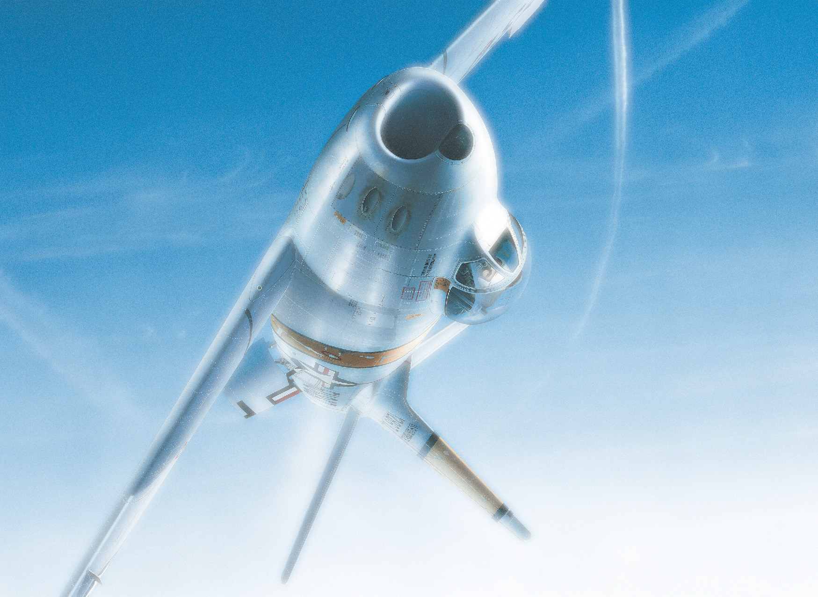
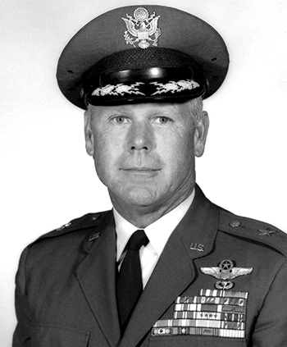
General Ben King
Memorial Gateway
Proposal
Sam Spayd
President Deeds of Valor
BGen Ben King

Slide 8
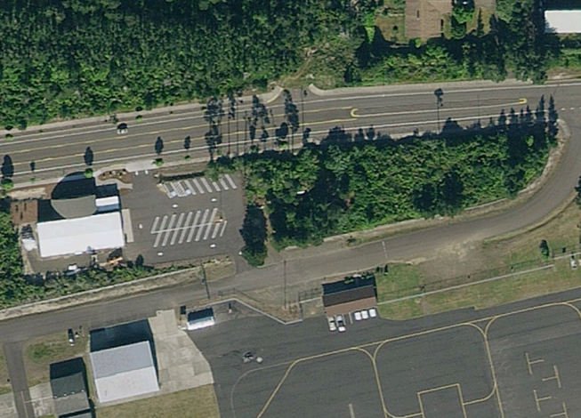
The Vision

Slide 9
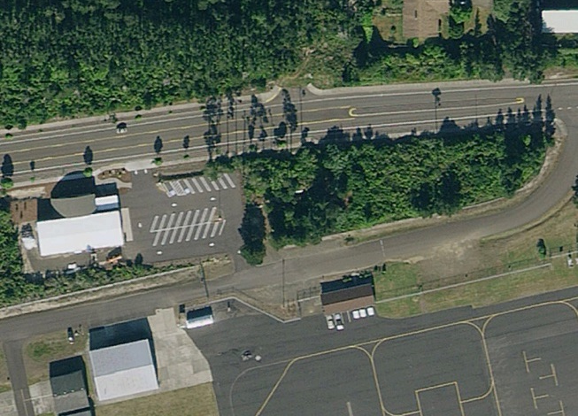
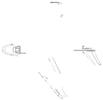
The Vision
Paths
Parking
Picnic
Tables
Static
Display
Pavilion
Parking

Slide 10
Airport Grants
&
Upcoming Projects

Slide 11
Subcommittee Ideas
Make the Airport Safe
Make the Airport Attractive to Visitors
Encourage New Hangars / Leases
  Standard Leases
Encourage Business at the Airport
  WiFi Availability

Slide 12
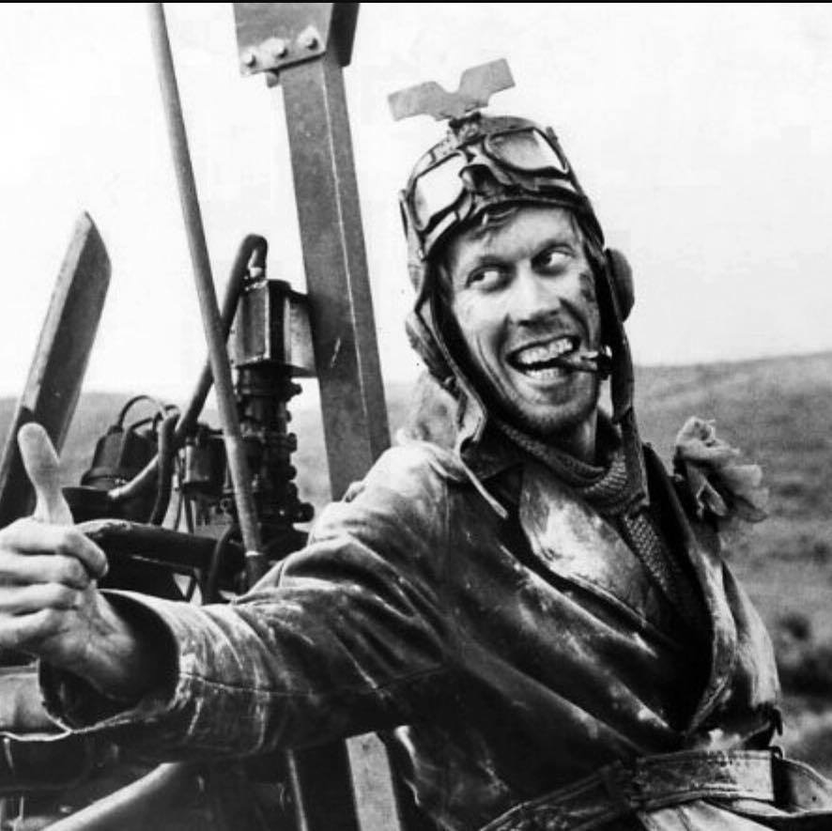
Questions?

