Slide 1
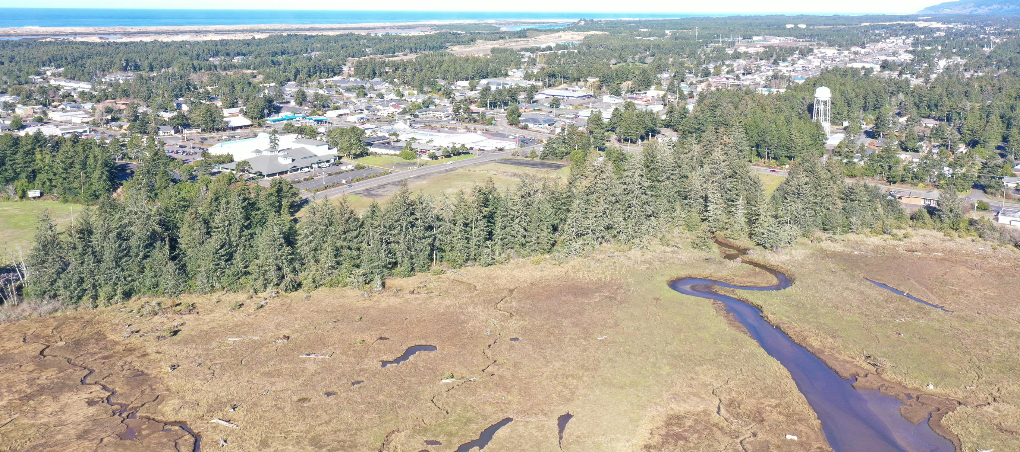
Estuary Trail
MIKE MILLER, DIRECTOR PUBLIC WORKS

Slide 2
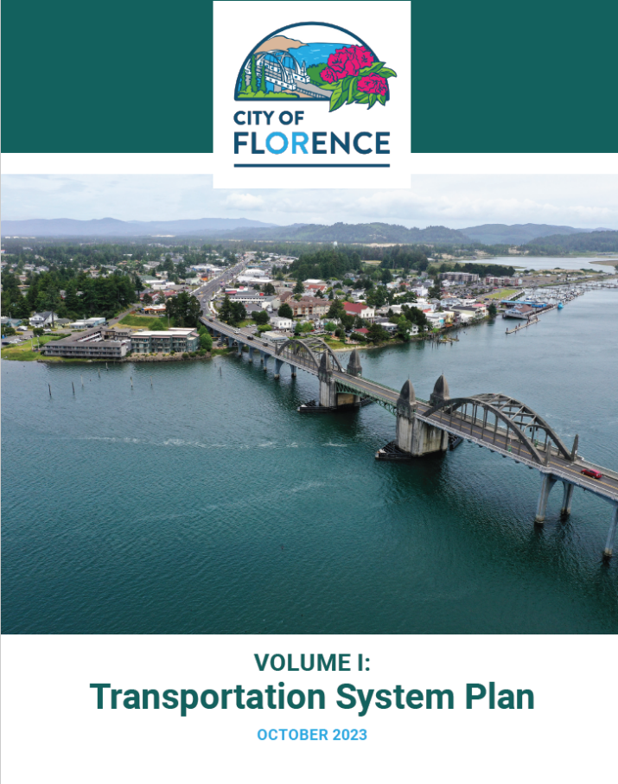
Siuslaw Estuary Trail
A community goal for over 22 years
“Establish an estuary trail connecting the Boardwalk to the Munsel Creek Bike path.” Downtown Plan
“The purpose of this project is to conduct preliminary scoping and alternatives analysis for a Siuslaw Estuary Interpretive Trail”
Siuslaw Estuary Partnership 2010
“Develop an estuary trail from Old Town, through the old Middle School site, to Gallagher Park” Parks & Rec Plan 2011
“accommodate other modes of transportation by building an on and offroad bicycle path behind the Siuslaw Middle School site” Transportation Plan 2012
“The City should pursue establishment of an estuary trail connecting the Boardwalk with the Munsel Creek bike/pedestrian trail.” Comp Plan 2018 Update
“Install a multi-use path from the Boardwalk in Old
Town to south end of Munsel Creek Trail” Transportation Plan 2023

Slide 3
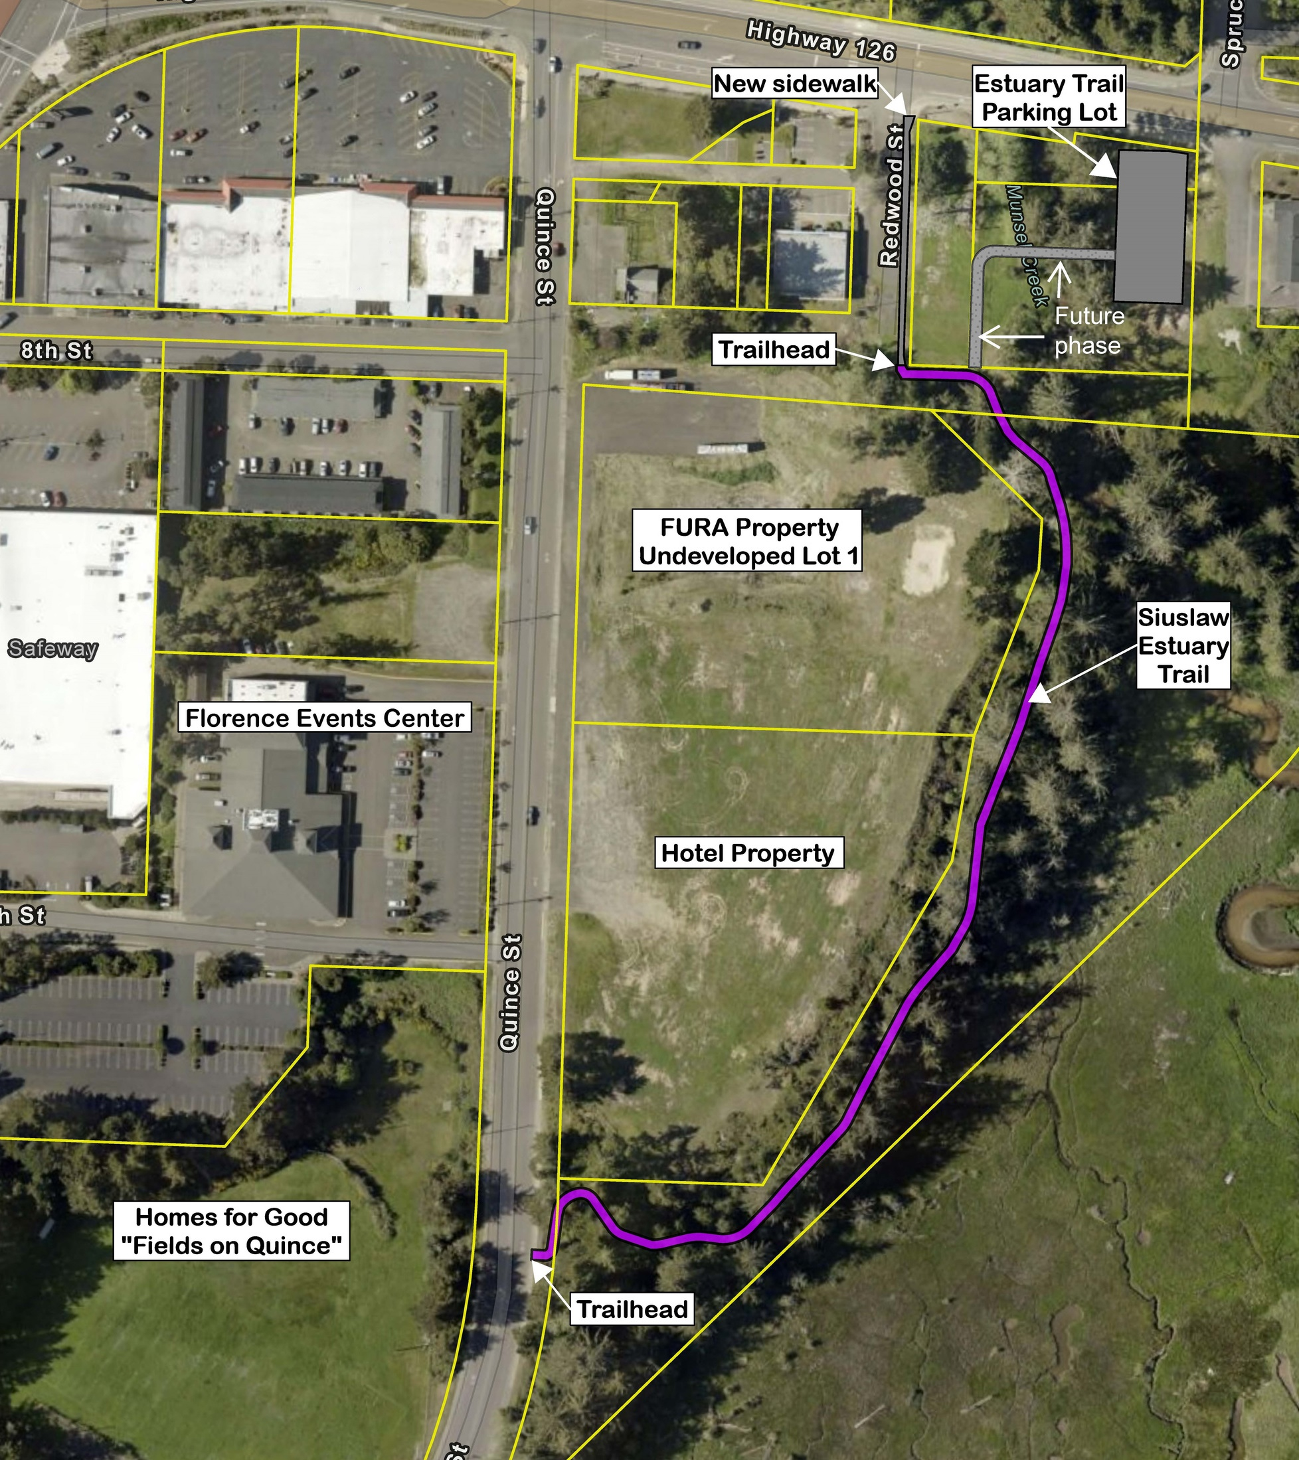

Slide 4
Pedestrian Activated Crossing Warning System
Spruce St. & Hwy 126

Slide 5
Trail Marking,
Wayfinding
& Accessibility

Slide 6
Trail Diagram
City of Portland
City of Florence

Slide 7
The accessible hiking trail requires fair balance and fitness. Single-file walking and (sometimes) running are desired use at minimum width. Wheelchairs (motorized or human-powered) and mobility scooters may be used, but surface is not as reliably firm and slip-resistant as a paved walking trail.

Slide 10
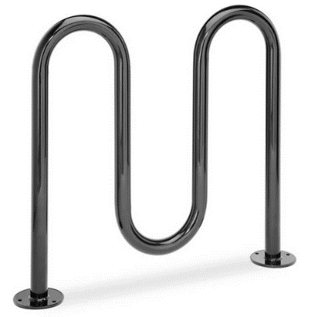
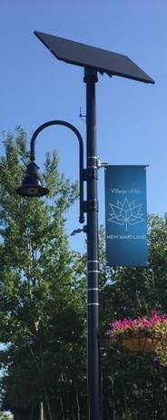
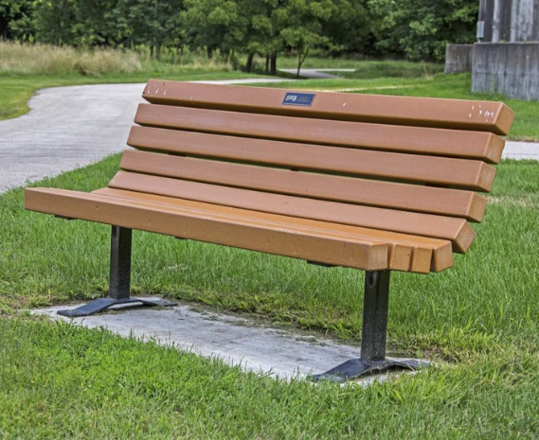
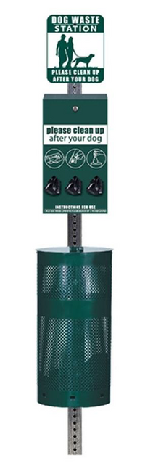
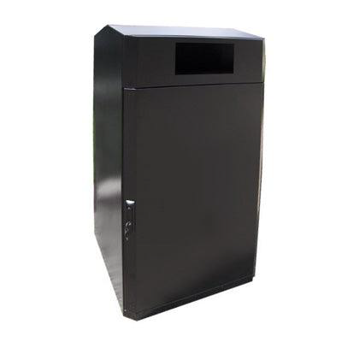
Trail
Amenities
Bench
Dog Waste Station
Bike Racks & Trash Can
Lights

Slide 11
Interpretative
Signage

Slide 12
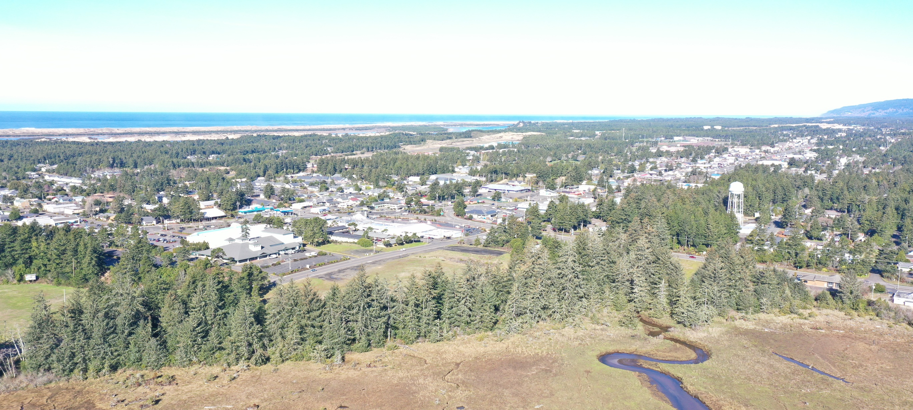
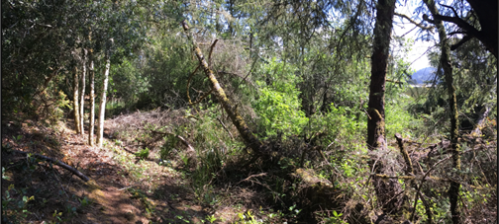
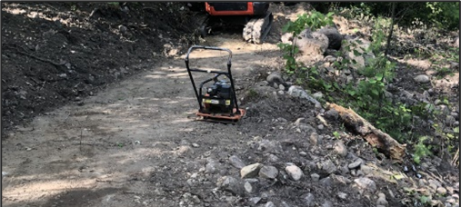
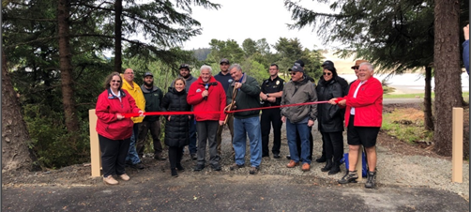
Next Steps / Time Line
Land Use
Out to Bid March 2024 – Construction contract award April 2024
Construction May – September 2024
Ribbon Cutting October/November 2024

Slide 13
Questions
MIKE MILLER, DIRECTOR PUBLIC WORKS

