Slide 1
Benedick Holdings, LLC Annexation and Zone Assignment
PC 20 22 ANN 01
PC 20 23 ZC 02

Slide 2
Introduction
July 30th –Petition/Application received
Aug. 28th –Deemed complete effective July 30th
October 6th –DLCD Notice made
October 13th-Property Owner notices mailed
October 28th—Revision with new hearing date
November 10th --First evidentiary hearing (PC)
Final evidentiary hearing (CC) TBD
Notes:
. Applicant has applied in order to connect to city sewer service. No utilities in area. Will be extended.
Properties Exhibits A for each resolution
Application requires zone “assignment” – basically implementing the appropriate zone which has been determined by the Comprehensive Plan.

Slide 3
Annexation Criteria
Oregon Revised Statutes:
ORS 222.111, 222.120, 222.125, and 222.170(2)
Florence Realization 2020 Comprehensive Plan:
1: Citizen Involvement, Policy 4
2: Land Use, Policy 6; Residential Policies 2, 7, 8 & 10; and Section on Residential Plan Designations
8: Parks, Recreation and Open Space; Parks and Recreation section, Policy 3
14: Urbanization, Annexation Section Policies 1 -- 7
17: Coastal Shorelands: Ocean, Estuary and Lake Shorelands, Policies 11 & 17 Prime Wildlife

Slide 4
Zone Assignment Criteria
Florence City Code, Title 10:
1: Zoning Regulations, Sections 10-1-1-6-4, 10-1-2-3, & 10-1-3
10 – Residential Districts, Section 1
19: Estuary, Shorelands, and Beaches and Dunes; Sections 5—Administration & 9-Prime Wildlife Overlay District
Florence Realization 2020 Comprehensive Plan:
1: Citizen Involvement, Policy 4
2: Land Use, Policy 6; Residential Policies 2, 7, 8 & 10; and Section on Residential Plan Designations
17: Coastal Shorelands: Ocean, Estuary and Lake Shorelands, Policies 11 & 17 Prime Wildlife
Oregon Land Use Planning Goals:
Goal 10 Housing
Notes:
OAR 660-015-0000 (Goal 10):
The zoning assignment for this annexation request does relate to the opportunity to provide additional residential uses. The addition of land to the city limits impact the City’s residential inventory in the City’s BLI in a positive way by adding more buildable land to the inventory to support additional housing.
The Housing Needs Analysis, 2017 Exhibit IV.6. identifies a forecasted need under Scenario A of 858 single family dwelling units with an estimated land need of 164 acres. The proposed zoning assignment to Low Density Residential for the 43+ acres creates a positive impact on the supply of residential land base. The proposal is consistent with this rule because it includes proposed zoning that support implementation of the adopted HNA, including needed housing types such as single family residential and accessory dwelling units providing the opportunity for housing units as identified above.

Slide 5
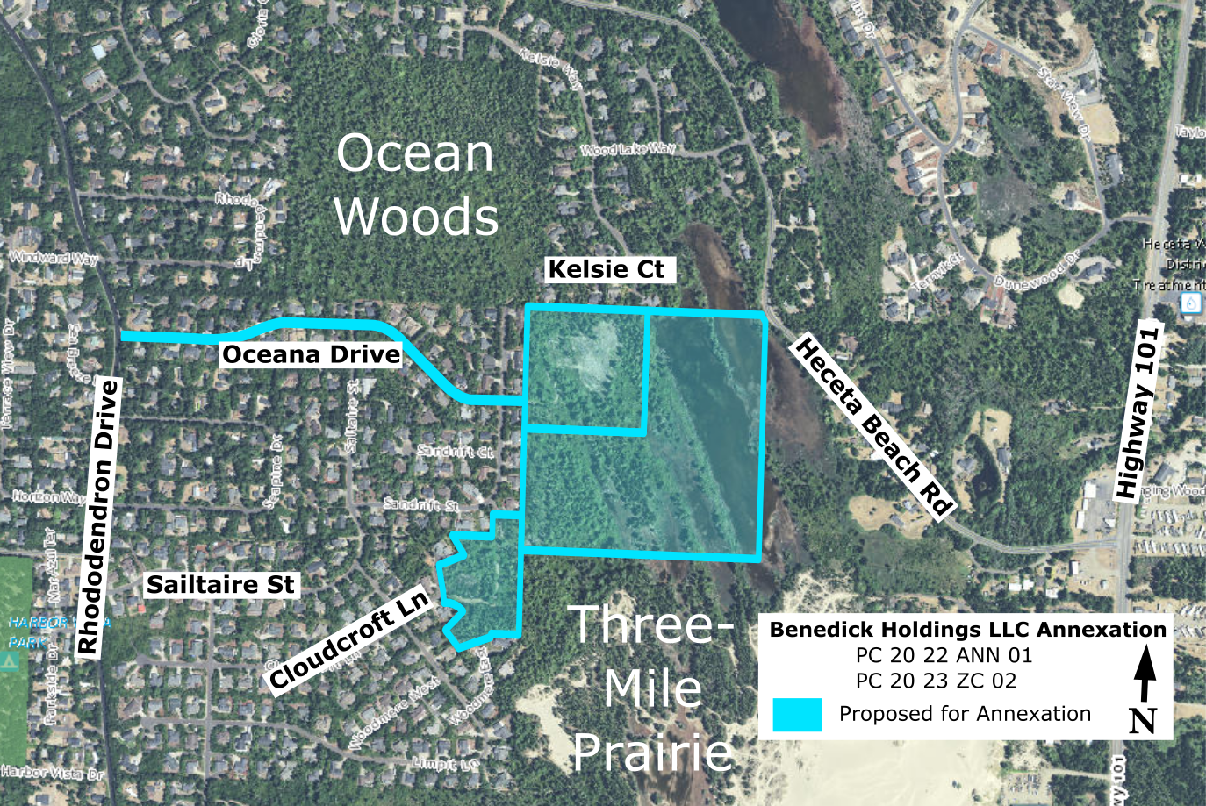
Aerial of Annexation Area

Slide 6
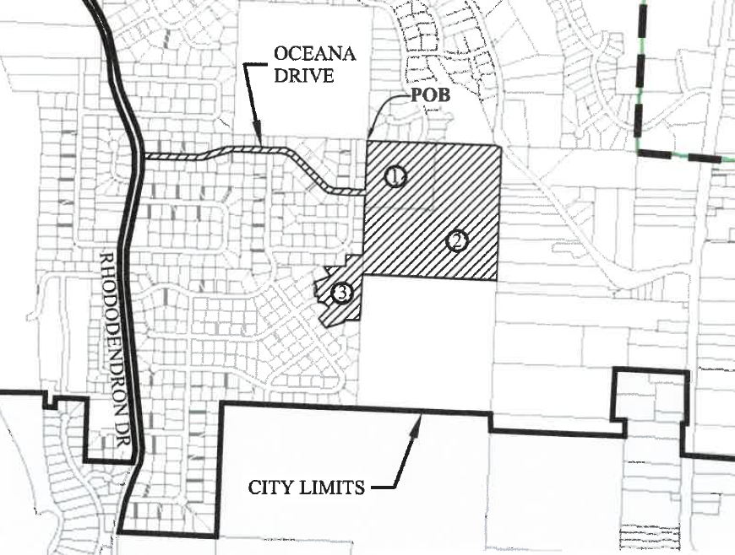
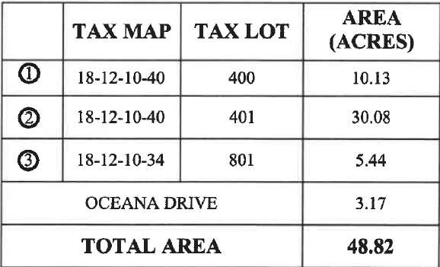
Annexation Request
Notes:
Exhibit A of Packets
Point out existing and proposed city limits

Slide 7
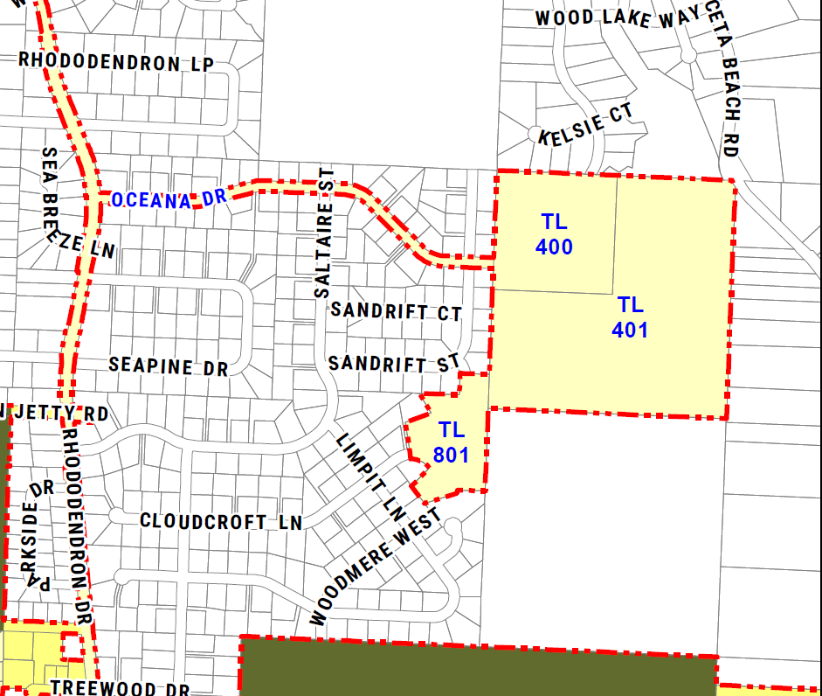
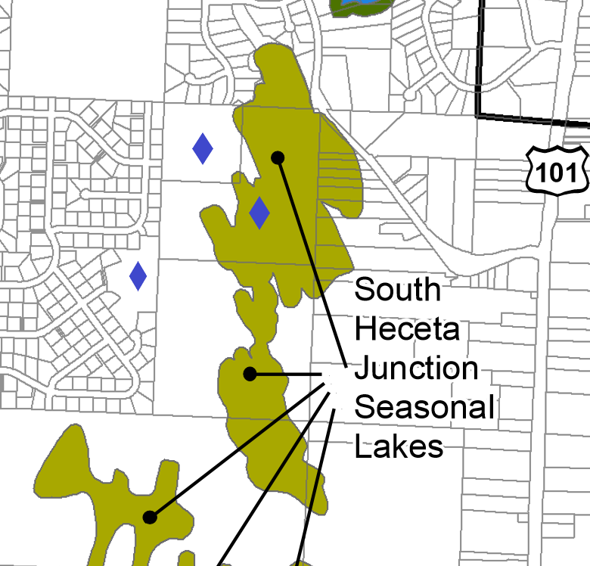
Proposed Zoning Assignment
Low Density Residential
Prime Wildlife Overlay
Notes:
Exhibit A of PC 16 17 ZC 02.
Commercial Plan Designation with corresponding implementing zone of Commercial District.

Slide 8
Public Comments
Multiple, Exhibits K1-77, concerns include:
  Wetland Areas
  Flooding
  Habitat
  Stormwater Drainage
  Additional Traffic on Roads
  Lack of Pedestrian Facilities

Slide 9
Referral Comments
Exhibits L 1-5:
Public Works Dept.:
  .555 mgd excess sewer capacity
  Oceana classification and jurisdictional transfer
  Groundwater considerations
  Water to be provided by Heceta Water PUD
Police Dept.:
  Has capacity to expand police response from current emergency response levels.
Notes:
Exhibit E

Slide 10
Referral Comments
Exhibits L 1-5:
Century Link: No Issues
Lane County Public Works:
  Streets-Recommend including Gulsettle Court, Cloudcroft Lane, and Kelsie
  Stormwater may not be directed to county roads or into county facilities.
Siuslaw Valley Fire and Rescue & Western Lane Ambulance: Will not affect service
Notes:
Exhibit E

Slide 11
Utilities & Access
Water: Remain on Heceta Water
Sewer: Connecting to existing pressure sewer in Rhody via Oceana Drive
Access: Existing street system, with needed improvements at development
Notes:
Chapter 14 Policy 3: Orderly, economic provision for public facilities and services

Slide 12
Consents
Both Double and Triple Majority methods are met
Notes:
Chapter 14, Policy 1. The City received a petition from the property owner representative with signature. No electors.
The proposed annexation is not an island annexation because the territory is not surrounded by the corporate boundaries of the city but rather contiguous with the Florence city limits on the south and a part of the east sides. Additionally, all properties to be annexed were petitioned by the owner.
This policy criterion is met
Double: 222.125: all of the owners of land in that territory and not less than 50 percent of the electors, if any, residing in the territory consent in writing to the annexation of the land in the territory and file a statement of their consent with the legislative body
Triple: 222.170: more than half of the owners of land in the territory, who also own more than half of the land in the contiguous territory and of real property therein representing more than half of the assessed value of all real property in the contiguous territory consent in writing to the annexation of their land in the territory and file a statement of their consent with the legislative body on or before the day

Slide 13
Alternatives
Provide a recommendation supporting the annexation and zone assignment to the City Council, or
Provide a recommendation to the City Council to deny the petition for annexation and zone assignment with reasons for the denial, or
Modify the findings, reasons, or conditions and provide a recommendation supporting the annexation and zone assignment to the City Council, or

Slide 14
Alternatives
Continue the Public Hearing to a date certain if more information is needed.
Close the public hearing and keep the written record open for a specified amount time continuing deliberations to a date certain

Slide 15
Staff Recommendation
Close the public hearing and keep the written record open for a specified amount time continuing deliberations to a date certain
Notes:
Could be added as part of the annexation agreement.

Slide 16
Questions?

