Slide 1
Rannow Arch St. Annexation and Zone Assignment
PC 21 09 ANN 03
PC 21 10 ZC 03

Slide 2
Introduction
Bob and Katherine Rannow submitted a petition for annexation on March 15, 2021, with Katherine’s signature added on May 24, 2021, to attain consent from 100% of the property owners.
Rannow Arch St. Annexation – PC 21 09 ANN 03 & PC 21 10 ZC 03

Slide 3
Introduction
Notice of the public hearing was provided to owners of property within 300’ of the petitioners’ property, but property owners within 300’ of the affected rights-of-way were not notified in time for the original May 25th meeting date.
The public hearing was postponed until June 22, 2021, to accommodate the 20-day notice period.
Rannow Arch St. Annexation – PC 21 09 ANN 03 & PC 21 10 ZC 03

Slide 4
Introduction
Public testimony identified issues with language in the Notice of Hearing, which stemmed from changes introduced during the shift to remote meetings.
With revised public notice, the public hearing was postponed until July 13, 2021.
Rannow Arch St. Annexation – PC 21 09 ANN 03 & PC 21 10 ZC 03

Slide 5
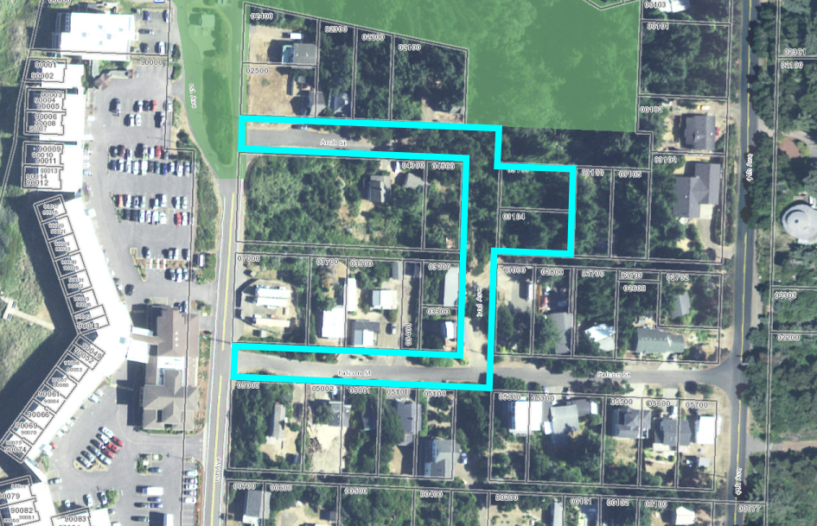
Vicinity Map
Arch Street
Proposed Annexation
Falcon Street
1st Avenue
2nd Avenue
4th Avenue
Rannow Arch St. Annexation – PC 21 09 ANN 03 & PC 21 10 ZC 03

Slide 6
Annexation Criteria
Oregon Revised Statutes:
ORS 222.111, 222.120, 222.125, 222.170, 373.270
Florence Realization 2020 Comprehensive Plan:
Chapter 1: Citizen Involvement, Policy 4
Chapter 2: Land Use, Policy 6; Residential Policies 2, 7, 8 & 10; and Section on Residential Plan Designations
Chapter 14: Urbanization, Annexation section, Policies 1 through 7
Florence City Code (FCC):
Title 10: Zoning Regulations, Sections 10-1-1-6-3, 10-1-1-6-4, and 10-1-3
Rannow Arch St. Annexation – PC 21 09 ANN 03 & PC 21 10 ZC 03

Slide 7
Zone Assignment Criteria
Florence Realization 2020 Comprehensive Plan:
Chapter 1: Citizen Involvement, Policy 4
Chapter 2: Land Use, Policy 6; Residential Policies 2, 7, 8 & 10; and Section on Residential Plan Designations
Chapter 14: Urbanization, Annexation section, Policies 1 through 7
Florence City Code (FCC):
Title 10 Chapter 1: Sections 10-1-1-6-3, 10-1-1-6-3, and 10-1-3
Title 10 Chapter 10: Section 1
Oregon Land Use Planning Goals:
Goal 10: Housing (OAR 660-015-0000)
Rannow Arch St. Annexation – PC 21 09 ANN 03 & PC 21 10 ZC 03

Slide 8
Vicinity Map
Arch Street
5
6
Proposed Annexation
1
4
3
Falcon Street
2
1st Avenue
2nd Avenue
4th Avenue
Rannow Arch St. Annexation – PC 21 09 ANN 03 & PC 21 10 ZC 03

Slide 9
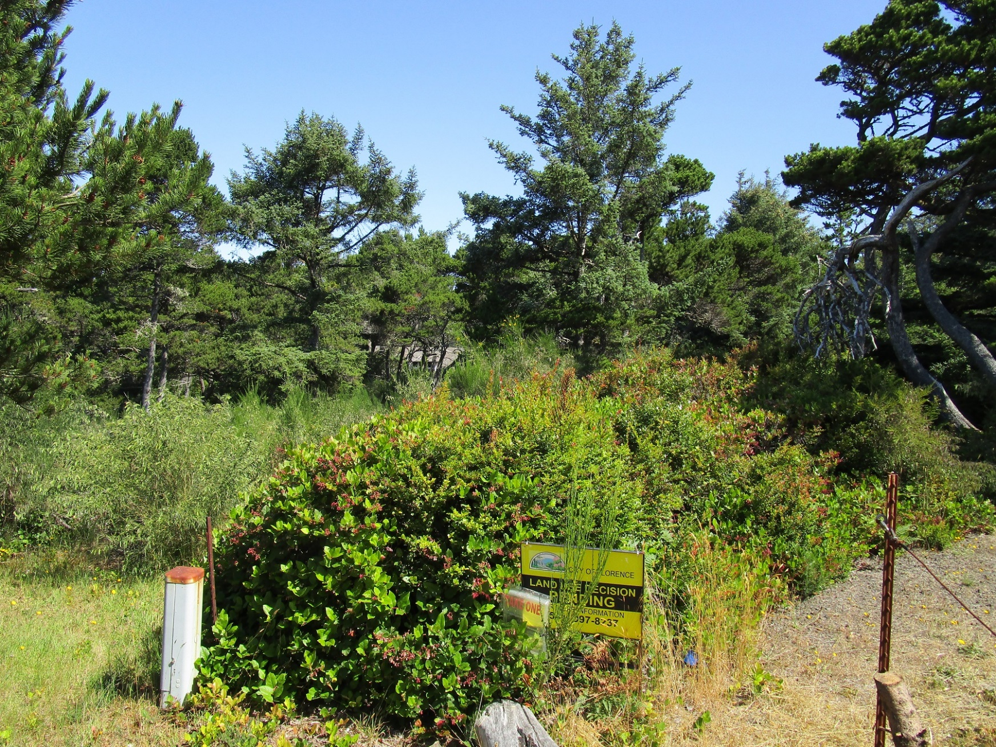
Petitioner’s Property from 2nd Avenue
Rannow Arch St. Annexation – PC 21 09 ANN 03 & PC 21 10 ZC 03

Slide 10
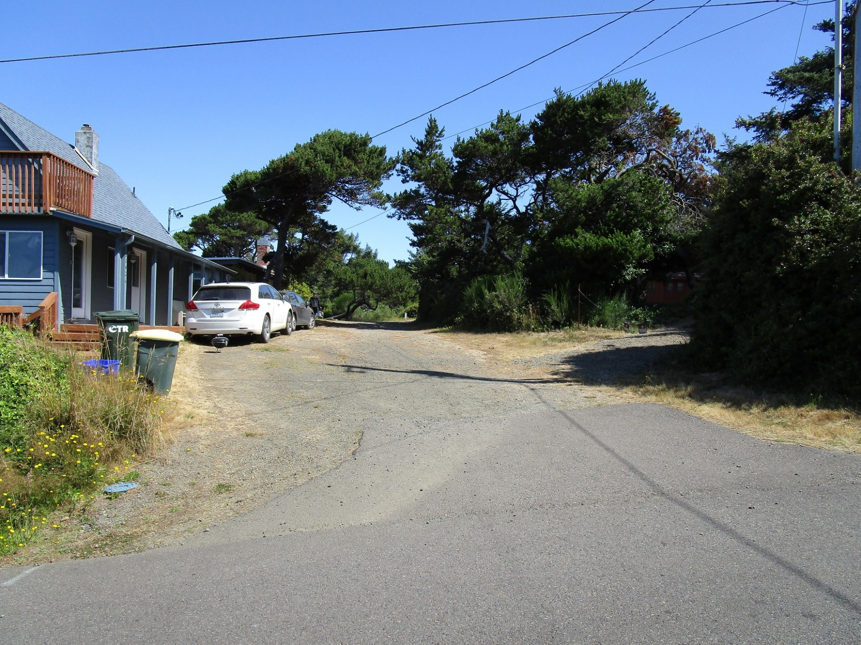
2nd Avenue from Falcon Street
Rannow Arch St. Annexation – PC 21 09 ANN 03 & PC 21 10 ZC 03

Slide 11
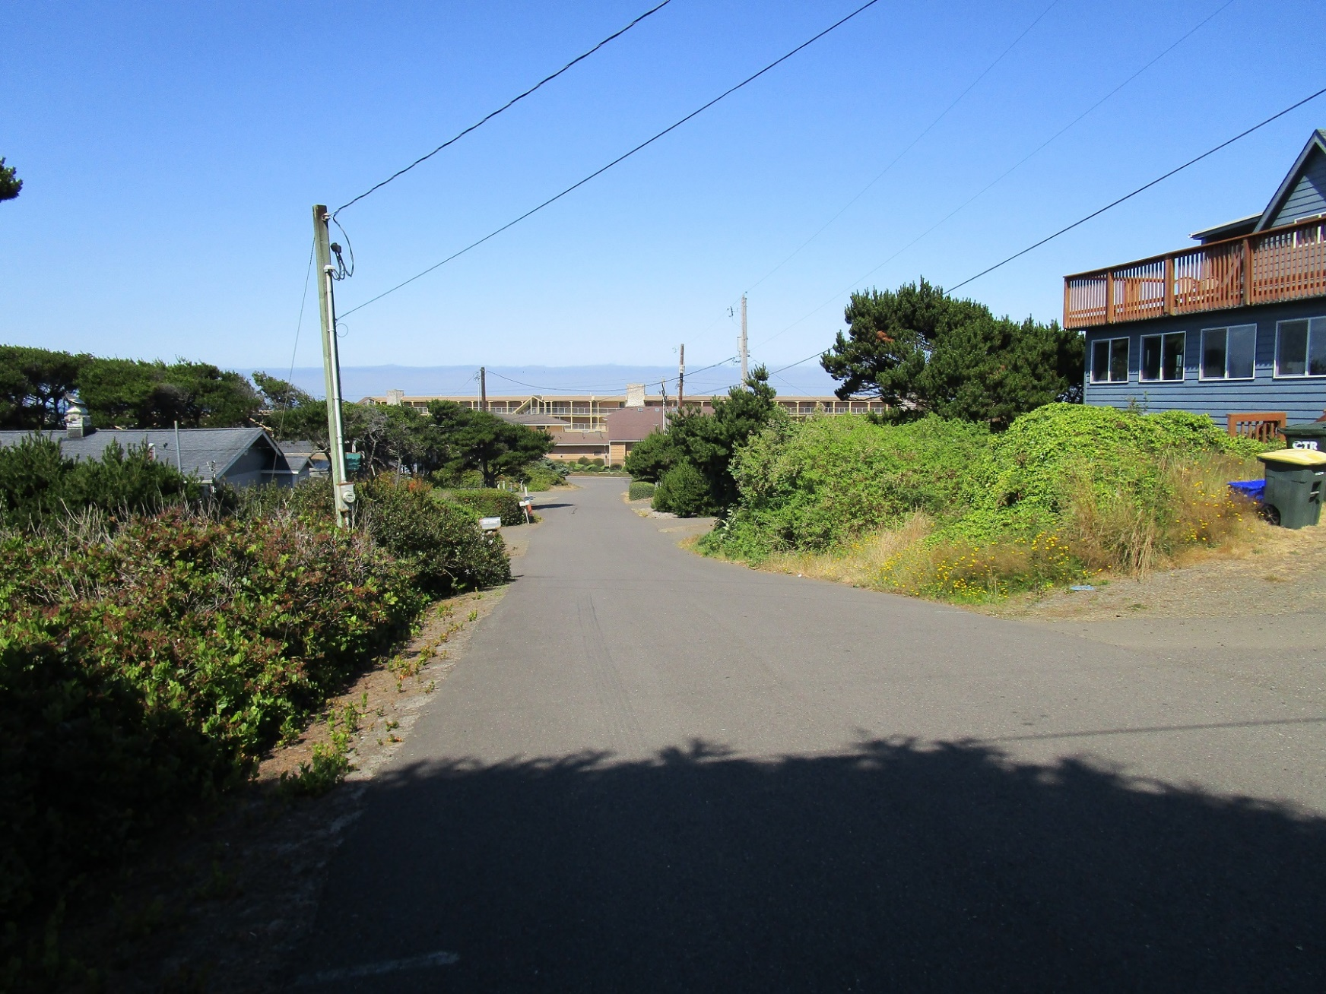
Falcon Street from 2nd Avenue
Rannow Arch St. Annexation – PC 21 09 ANN 03 & PC 21 10 ZC 03

Slide 12
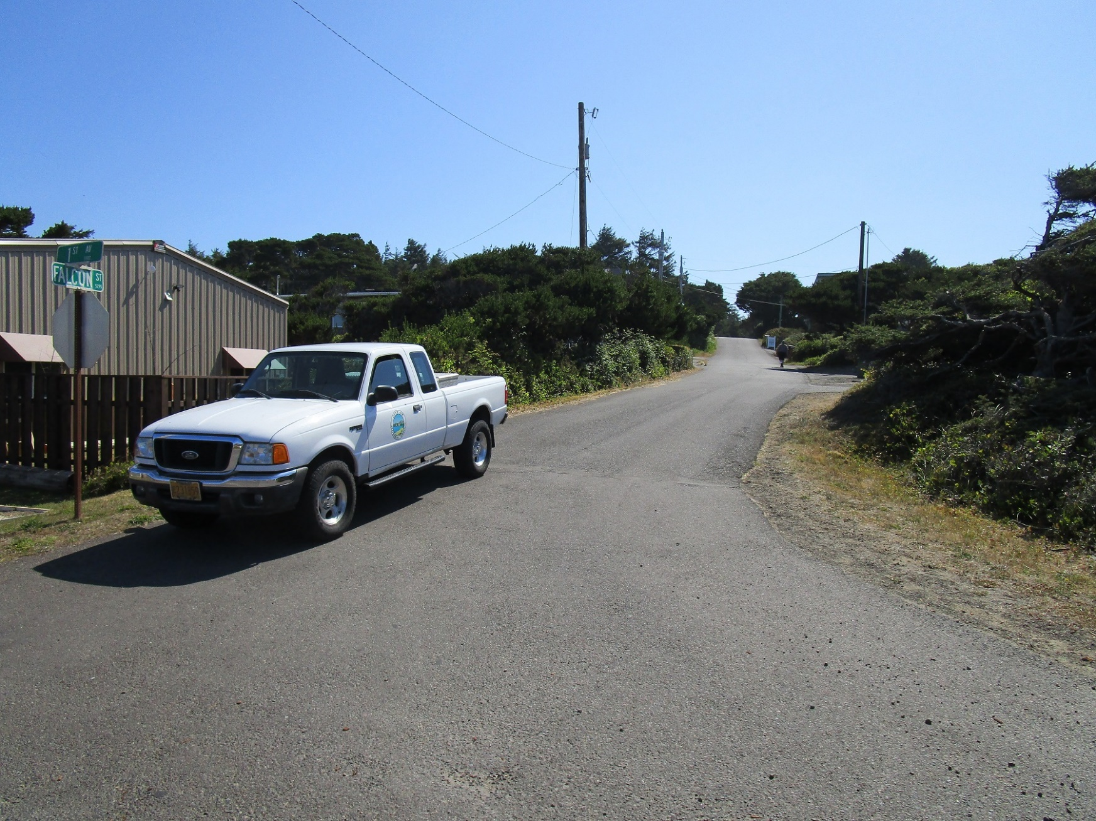
Falcon Street from 1st Avenue
Rannow Arch St. Annexation – PC 21 09 ANN 03 & PC 21 10 ZC 03

Slide 13
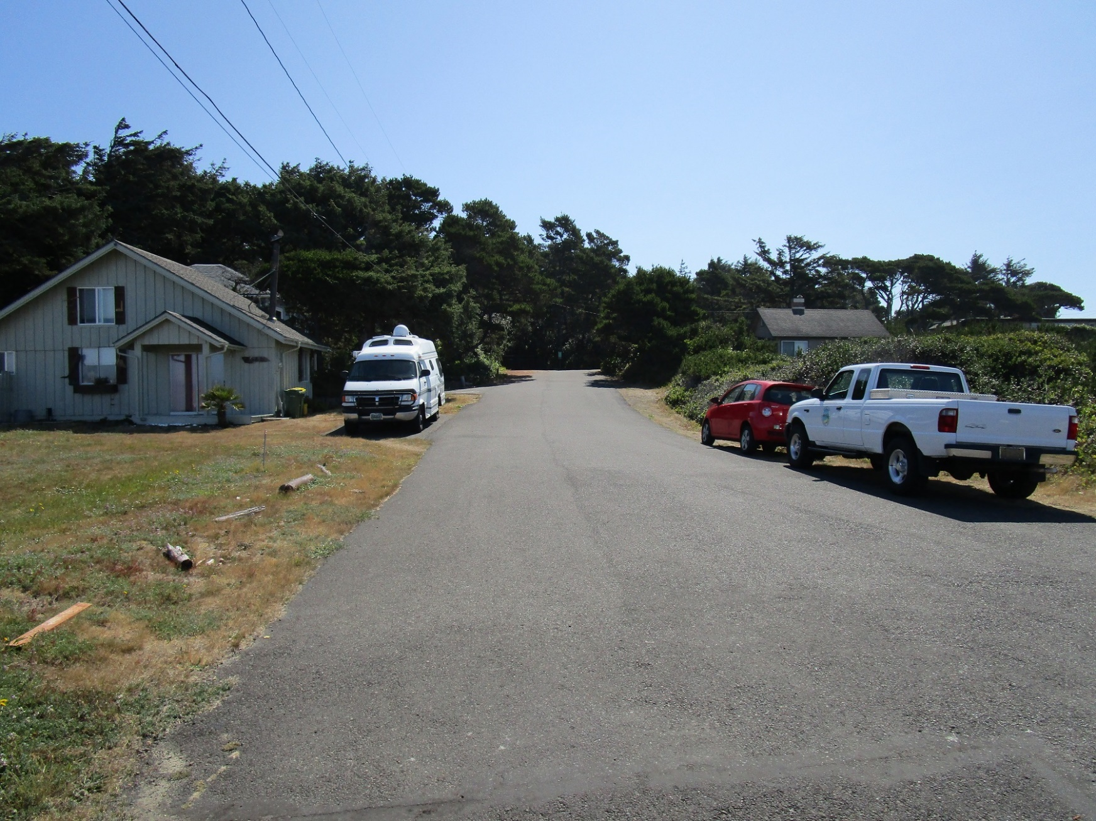
Arch Street from 1st Avenue
Rannow Arch St. Annexation – PC 21 09 ANN 03 & PC 21 10 ZC 03

Slide 14
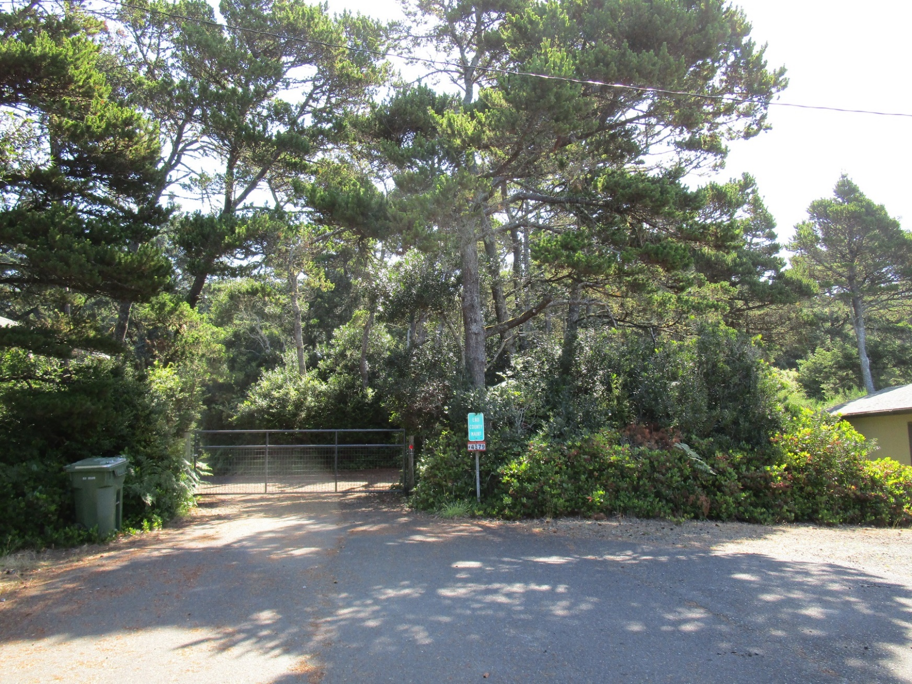
Arch Street from 1st Avenue
Rannow Arch St. Annexation – PC 21 09 ANN 03 & PC 21 10 ZC 03

Slide 15
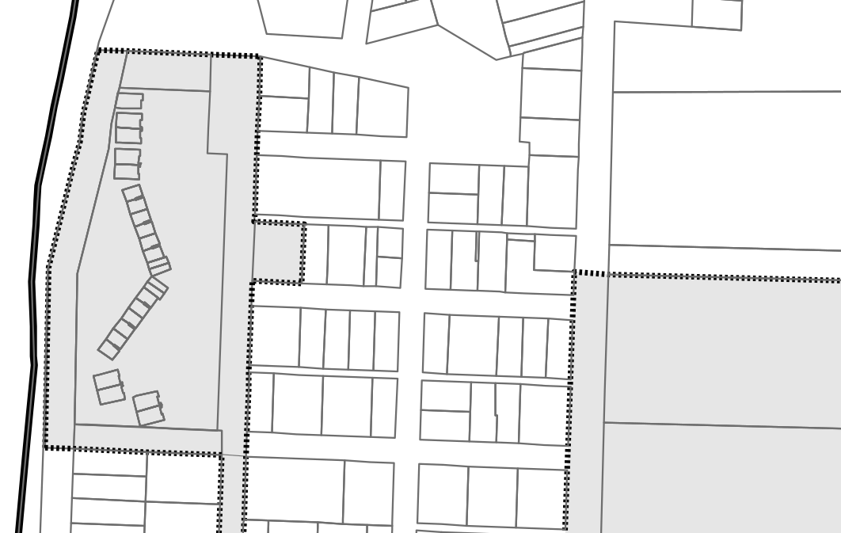
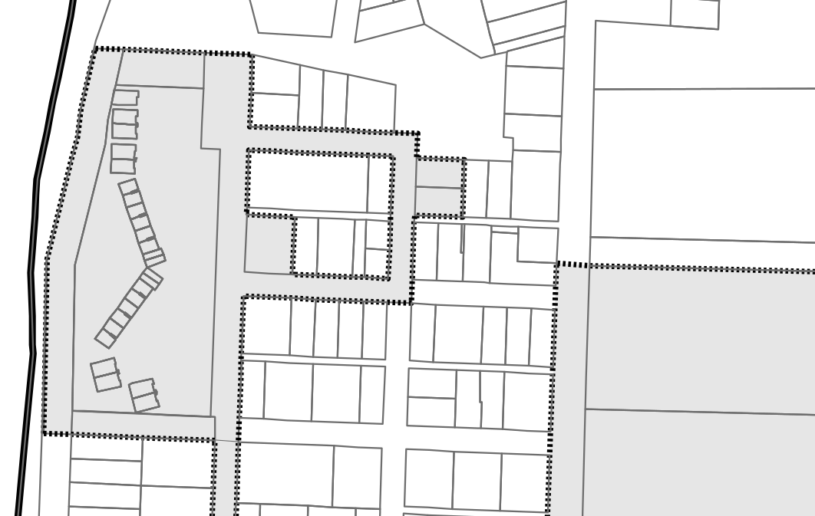
Annexation Map
Arch St.
Arch St.
Falcon St.
Falcon St.
1st Avenue
1st Avenue
2nd Avenue
2nd Avenue
Before Annexation
After Annexation
Rannow Arch St. Annexation – PC 21 09 ANN 03 & PC 21 10 ZC 03

Slide 16
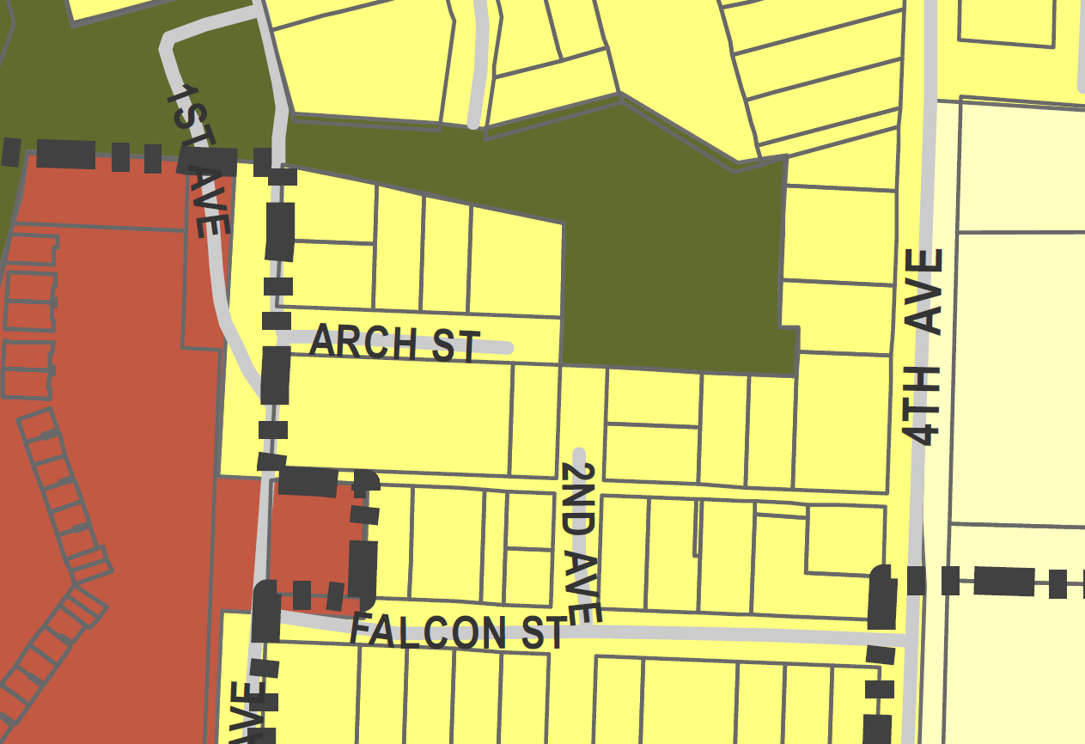
Comprehensive Plan Designation
Rannow Arch St. Annexation – PC 21 09 ANN 03 & PC 21 10 ZC 03

Slide 17
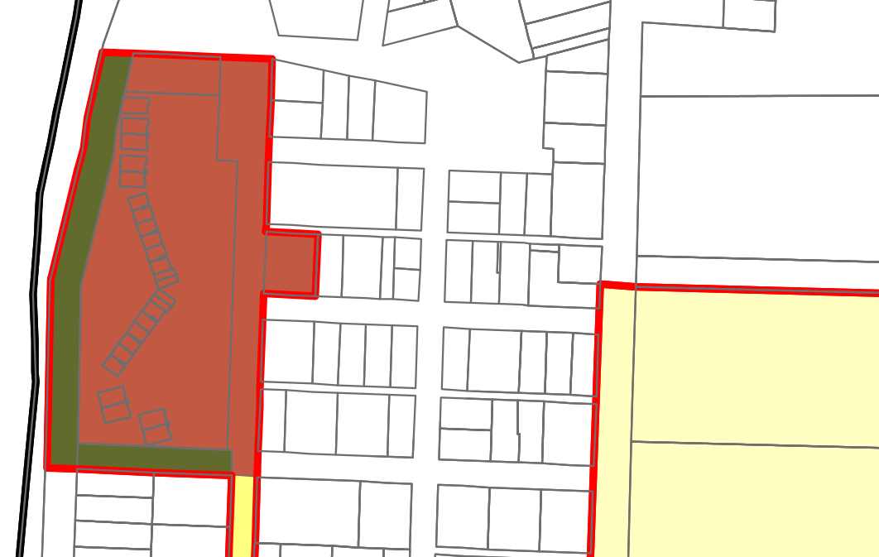
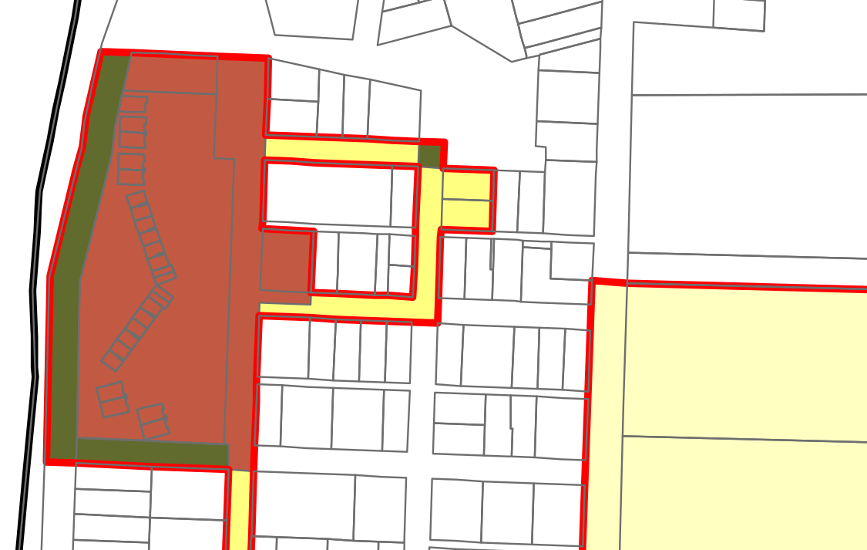
Zoning Map
Arch St.
Arch St.
Falcon St.
Falcon St.
1st Avenue
1st Avenue
2nd Avenue
2nd Avenue
Before Zone Assignment
After Zone Assignment
Rannow Arch St. Annexation – PC 21 09 ANN 03 & PC 21 10 ZC 03

Slide 18
Referral Comments
Public Works Dept.:
  Sewer provision information
CTCLUSI:
  Requested immediate contact if cultural resources are found during work
Lumen (formerly CenturyLink):
  Facilities in the annexation area; any necessary relocations would be funded by the property owner
Rannow Arch St. Annexation – PC 21 09 ANN 03 & PC 21 10 ZC 03
Notes:
Exhibit E

Slide 19
Referral Comments
Lane County Transportation Planning:
  Arch St. is classified as an Urban Local Road.
  LC supports annexation to provide opportunity for future jurisdictional transfer.
  Until jurisdictional transfer occurs, development must comply with Lane County road requirements.
  Stormwater runoff must not be directed to LC roads or drainage facilities.
Rannow Arch St. Annexation – PC 21 09 ANN 03 & PC 21 10 ZC 03
Notes:
Exhibit E

Slide 20
Utilities & Access
Water: Connect to Heceta Water
Access: Street access via Falcon St. and improvement of 2nd Avenue
Rannow Arch St. Annexation – PC 21 09 ANN 03 & PC 21 10 ZC 03

Slide 21
Utilities & Access
Sewer: Connect to gravity wastewater line between Driftwood Shores and the pump station in 1st Ave.
  Arch St. provides the shortest available distance to serve the property, reducing cost for the City and the property owner.
Rannow Arch St. Annexation – PC 21 09 ANN 03 & PC 21 10 ZC 03

Slide 22
Consents
Both Double and Triple Majority methods are met (100% of owners and 100% of electors consent to annexation).
Rannow Arch St. Annexation – PC 21 09 ANN 03 & PC 21 10 ZC 03

Slide 23
Public Testimony
Comments received from property Arch St. Residents:
  Arch St. was not intended for development, and clearing for sewer or street extension would harm adjacent properties
  Wetlands and the North Dunal Aquifer would be harmed by street development
See Findings of Fact for additional comments and staff responses.
Rannow Arch St. Annexation – PC 21 09 ANN 03 & PC 21 10 ZC 03

Slide 24
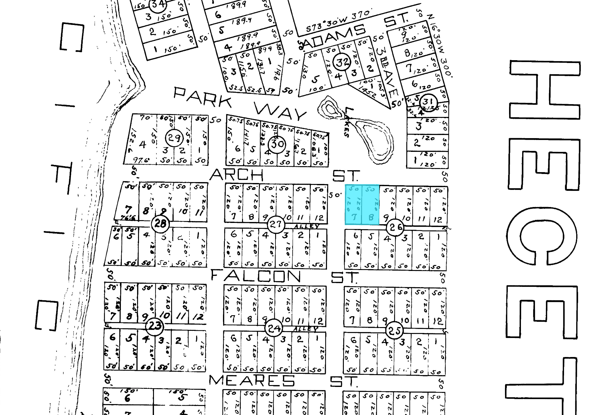
1915 Plat of Heceta Beach Subdivision
Rannow Arch St. Annexation – PC 21 09 ANN 03 & PC 21 10 ZC 03

Slide 25
Heceta Beach Park
Rannow Arch St. Annexation – PC 21 09 ANN 03 & PC 21 10 ZC 03

Slide 26
Conditions of Approval
None
Rannow Arch St. Annexation – PC 21 09 ANN 03 & PC 21 10 ZC 03

Slide 27
Alternatives
Recommend approval the annexation and zone assignment as presented or with modifications;
Recommend denial of the annexation based on the Commission’s findings;
Recommend approval of the annexation but recommend a different annexation area;
Recommend approval of the annexation but recommend a different zoning district; or
Continue the Public Hearing to a date certain if more information is needed.
Rannow Arch St. Annexation – PC 21 09 ANN 03 & PC 21 10 ZC 03

Slide 28
Staff Recommendation
Staff finds that the proposed application can meet the requirements of City Code with conditions of approval as presented, including modifications as discussed.
Staff recommends approving a recommendation to the City Council supporting annexation and a zoning assignment of Medium Density Residential with rights-of-way zoned in accordance with the Realization 2020 Comprehensive Plan.
Rannow Arch St. Annexation – PC 21 09 ANN 03 & PC 21 10 ZC 03

Slide 29
Questions?
Rannow Arch St. Annexation – PC 21 09 ANN 03 & PC 21 10 ZC 03

