Slide 1
Community Development Work Plan Land Use
Wendy FarleyCampbell,
Planning Director
9/22/20

Slide 2
Overview
2019-2021 Status
Planning Commissioner Input
Proposed Carry Over
Staff Input
Housing Needs Analysis Policies

Slide 3
2019-2021 Status
FEMA Floodplain FIRM Panel update
Title 4 Chapter 4 Floodplain Code and Comp Plan updates
Transportation Systems Plan Update--Pending Grant Notice
Residential Code Updates, Phase 1
Miscellaneous Code Amendments
PC Digital Packet Delivery
Mural Code Update
Lighting Code Update—Parking Lot

Slide 4
Planning Commissioner Input
Carry-Over from 2019-2021 Work Plan
Additions to existing objectives/tasks
New Ideas/Concepts

Slide 5
Proposed Carry Over
Transportation Systems Plan Update
Committee driven, staff facilitated/managed and contractual counts
Residential Code Updates, Phase 2, short term rentals, RV park, special, transitional, emergency, Phase 1 revisit
Miscellaneous Code Amendments
Mural Code Update
Lighting Code Update—Parking Lot

Slide 6
Staff Input
Industrial building architectural standards
Vegetation Preservation—Greenbelts, setbacks, etc.—add-on
Old Town Parking Assessment @ Wayfinding
Commercial Districts—Use Lists, On-site Outdoor Cafes, Neighborhood Commercial Use
Parking—Compact standards, ADA standards
Stormwater Design Manual Updates, planting density, setbacks, etc.
Affordable Housing Incentives—density bonuses…

Slide 7
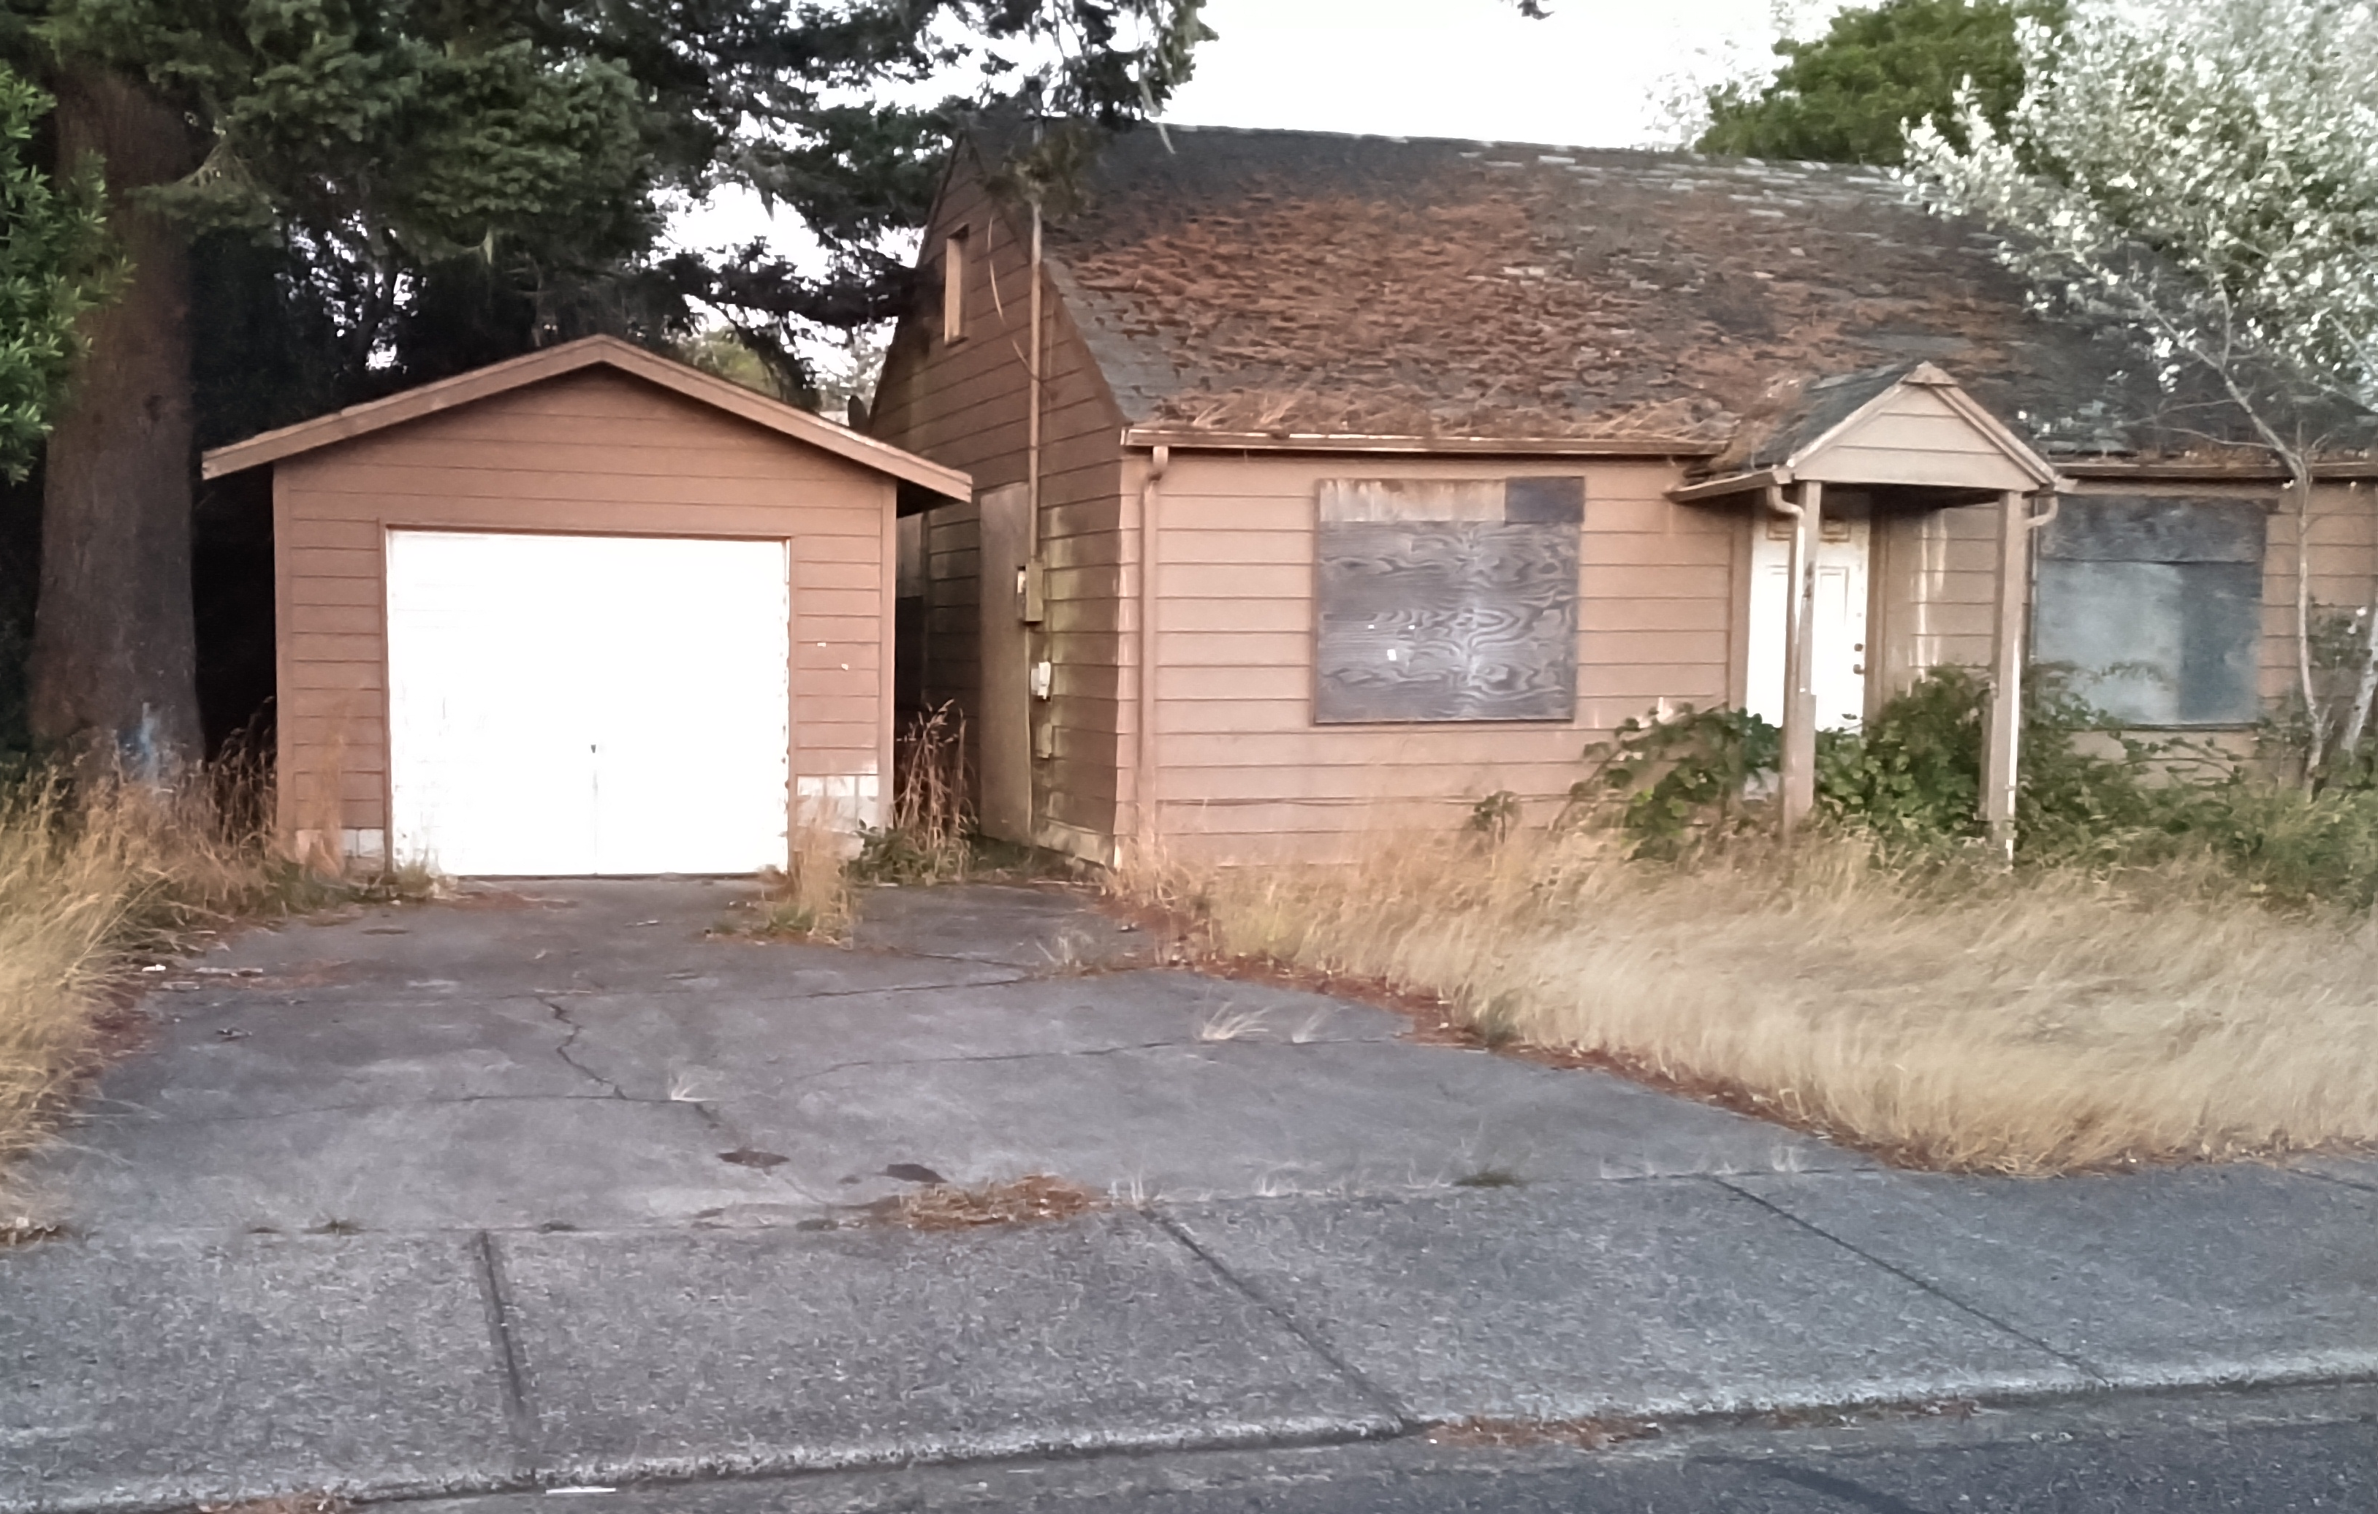
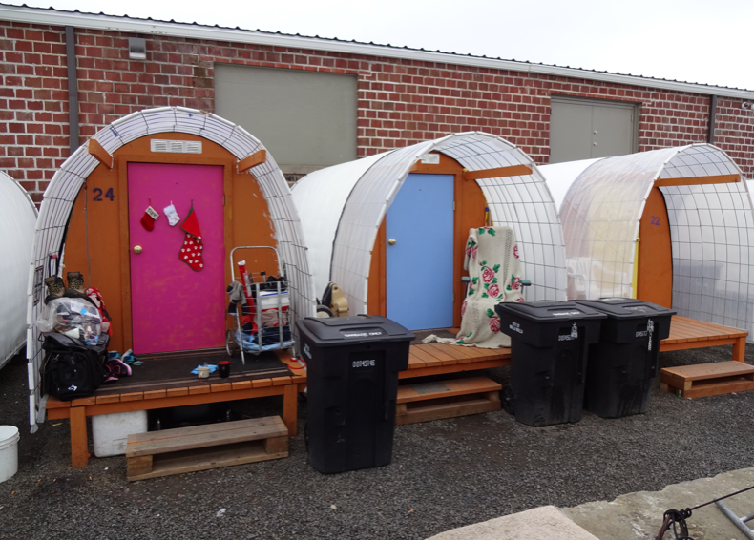
Housing Needs Analysis Policies
Incentivize Affordable Housing
Levy or CET funding
10-20 year property tax exemption
Density bonuses & parking reductions
Capital Improvement Plan prioritized to support affordable housing—access to undeveloped areas
Encourage rehabilitation of substandard housing stock
Residential Code Updates--short term rentals, RV park, special, transitional

Slide 8
Questions

