Slide 1
Florence Golf Links
Preliminary Planned Unit Development (PUD) &
Tentative Subdivision Plat (SUB)
PC 20 07 PUD 01
PC 20 08 SUB 01

Slide 2

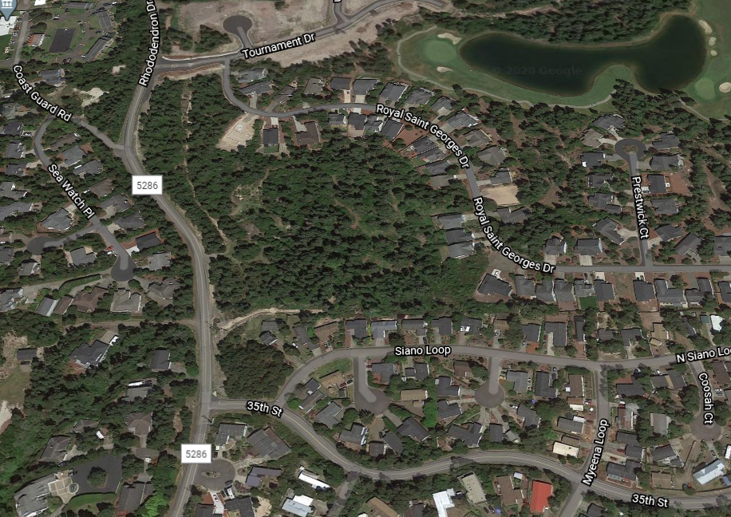
Site Location
Zoning: RMH
Comp Plan Designation: MDR
Map & Tax:
Map #: 18-12-15-33, Tax Lot 0700;
Tax Lots: 8900, 9000, 9200
Map #: 18-12-15-34, Lots 3800, 3900, 4000, 4100 & 4200
Map #: 18-12-22-21, Lot 1900
N

Slide 3
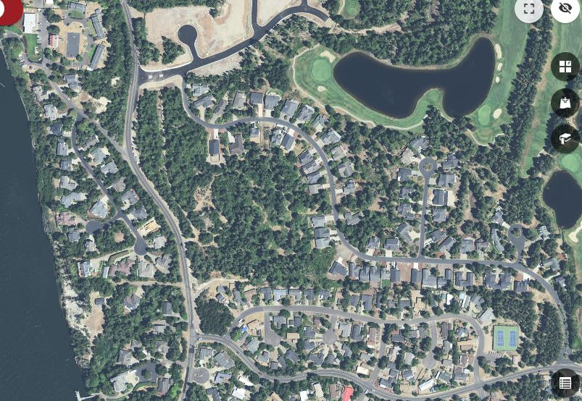
Zoning: RMH
Comp Plan Designation: MDR
Map & Tax:
Map #: 18-12-15-33, Tax Lot 0700;
Tax Lots: 8900, 9000, 9200
Map #: 18-12-15-34, Lots 3800, 3900, 4000, 4100 & 4200
Map #: 18-12-22-21, Lot 1900
Tournament Dr.
Coast Guard Rd.
Royal St. Georges Dr.
Site
Rhododendron Dr.
Siano Loop
35th St.

Slide 4
Summary
August 25th Planning Commission closed public hearing after leaving written record open until Friday, Sept. 4, 2020.
Applicant and staff was instructed to meet on Conditions 11 (related to traffic counts) and conditions related to stormwater (Conditions 30 and 31).
Applicant was also instructed to speak with Jim Hanks, P.E.

Slide 5
Summary
All parties met starting Sept. 26.
Applicant conducted new traffic counts (E. G2)
Testimony through Sept 4 included concerns regarding stormwater, vegetation preservation, traffic safety, including tsunami routes, short term rentals, and density.
AASHTO or Harmelink methods for determining need for left-hand turn lane?

Slide 6
Summary
Stormwater needs land use approval prior to site disturbance. This may be done with Phase II Site Investigation application and before Design Review and Final Plat approvals.

Slide 7
APPLICABLE REVIEW CRITERIA
Florence City Code:
Title 10: Zoning Regulations
Ch. 1: Zoning Administration,
Sections 1-4, 1-5; 1-6-3; 1-7
Ch. 2: General Zoning Provisions, Section 2-3, Sections 2- 8 & 2-13
Ch. 3: Off-Street Parking and Loading, Sections 3 thru 11
Ch. 6: Design Review, Section 6-6
Ch. 7: Special Development Standards, Sections 1, 2, 3H, 6 & 7

Slide 8
APPLICABLE REVIEW CRITERIA (cont.)
Ch. 10: Residential Districts. Sections 1, 2, 3, Table 10-10-3-A, 4, 5, 7, & 9
Ch. 23: Planned Unit Development, Sections 1 thru 10 & Section 15
Ch. 34: Landscaping, Sections 2 thru 5
Ch. 35: Access and Circulation, Sections 2-2 thru 2-14, 3-1 thru 3-4.
Ch. 36: Public Facilities, Sections 2-1 thru 2-5; 2-7, 2-8; 2-10 thru 2-19; 2- 22, 2-23; & Sections 3 thru 9
Ch. 37: Lighting, Sections 2 thru 6

Slide 9
APPLICABLE REVIEW CRITERIA (cont.)
Title 9: Utilities
Ch. 5: Stormwater Management Requirements, Sections 1 thru 7

Slide 10
APPLICABLE REVIEW CRITERIA (cont.)
Title 11: Subdivision Regulations
Ch. 1: Subdivision Administration General Provision, Sections 1 thru 8
Ch. 3: Subdivision Tentative Plan Procedure, Sections 1 thru 4, & 8
Ch. 5: Platting and Mapping Standards, Sections 5-1 thru 5-4
Ch. 7: Application for Modification

Slide 11
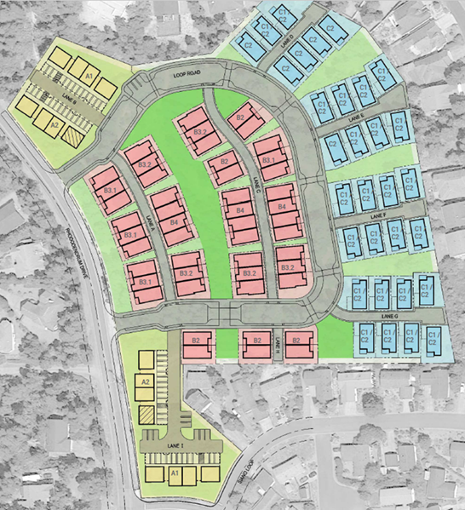
Proposed Site
Multi-Family
Detached
Residential
Attached Residential
Multi-Family

Slide 12
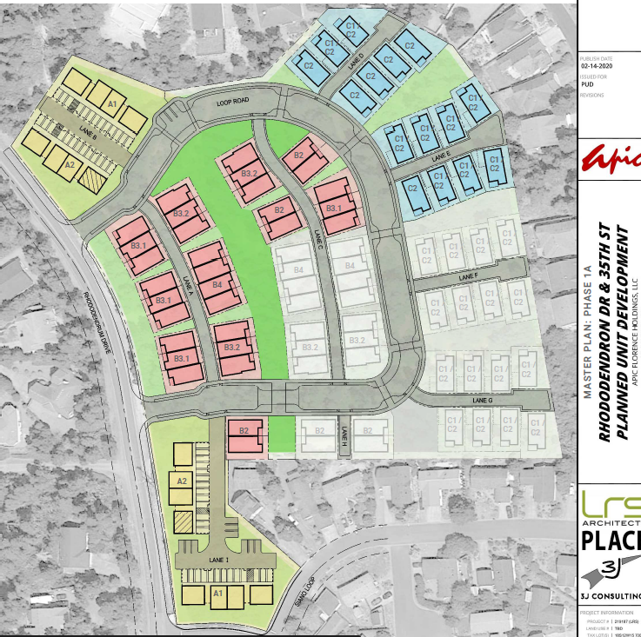
Proposed Phase 1A Plan
Phase 1A
Units: 92
Open Space: 20.7%
Rec. Space: 39.8%
Lot: 7.09 Acres
Est. Time to Complete: 16 mos.
N

Slide 13
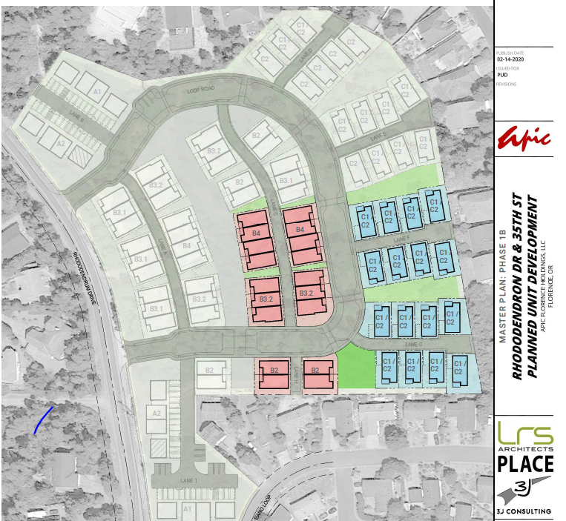
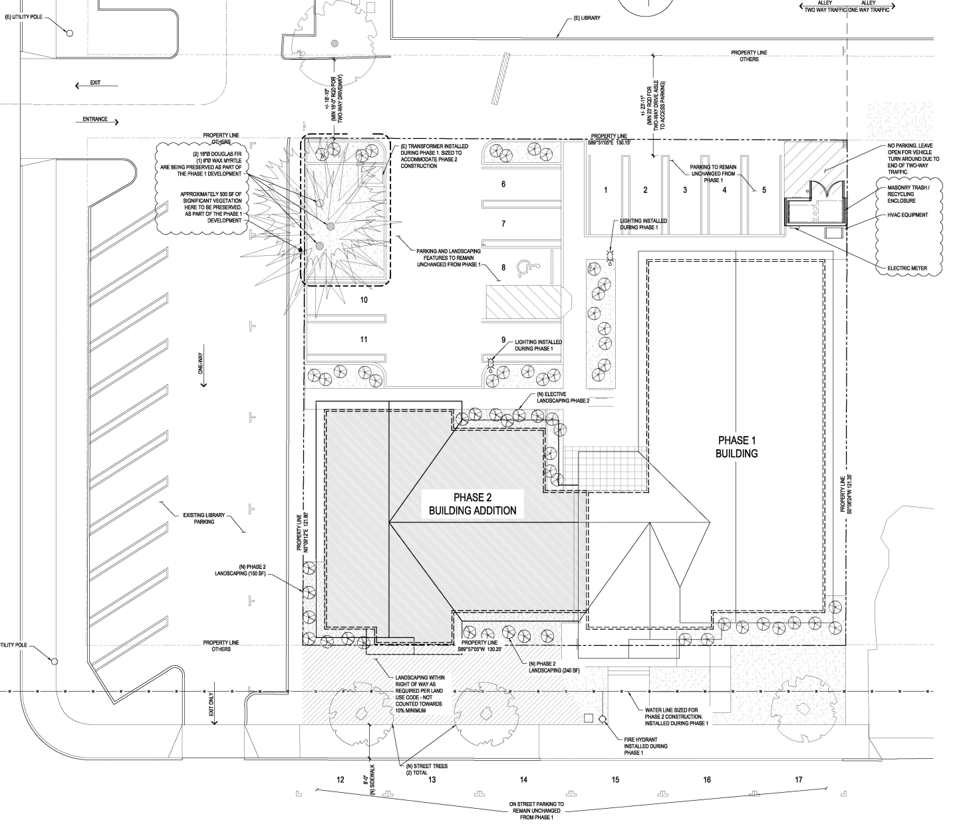
Proposed Phase 1B Plan
Phase 1B
Units: 34
Open Space: 4.4%
Rec. Space: 25%
Lot: 2.19 Acres
Est. Time to Complete: 9 -10 mos.
N

Slide 14
Testimony Concerns
Multiple Testimonies – posted online- Traffic Safety Stormwater Density Quality of life Tsunami Evacuation Routes Greenbelt conservation Increase in crime Need additional open/rec space

Slide 15
Peer Review
Confederated Tribes
Century Link - Stormwater
Jim Hanks, P.E.-Traffic Impact Study
GSI Stormwater Solutions, Inc. –Stormwater
Tony Miller-Fire Marshal w/ Siuslaw Fire and Rescue
Mike Miller-Public Works Director, City of Florence

Slide 16
Time Table for Application
Aug. 25 – First Evidentiary Public Hearing
Aug. 19– Notice published in Siuslaw News
Aug. 5– Notices resent & reposted
July 14 – Planned Public Hearing--rescheduled
July 7- Original Public Hearing published in Siuslaw news
June 23– Notices originally sent & posted
June 14 – Aug. 24 – Referrals sent and submitted to Planning Dept.
May 11 – Application deemed “complete”
Notes:
Previously, on Young and the Restless

Slide 17
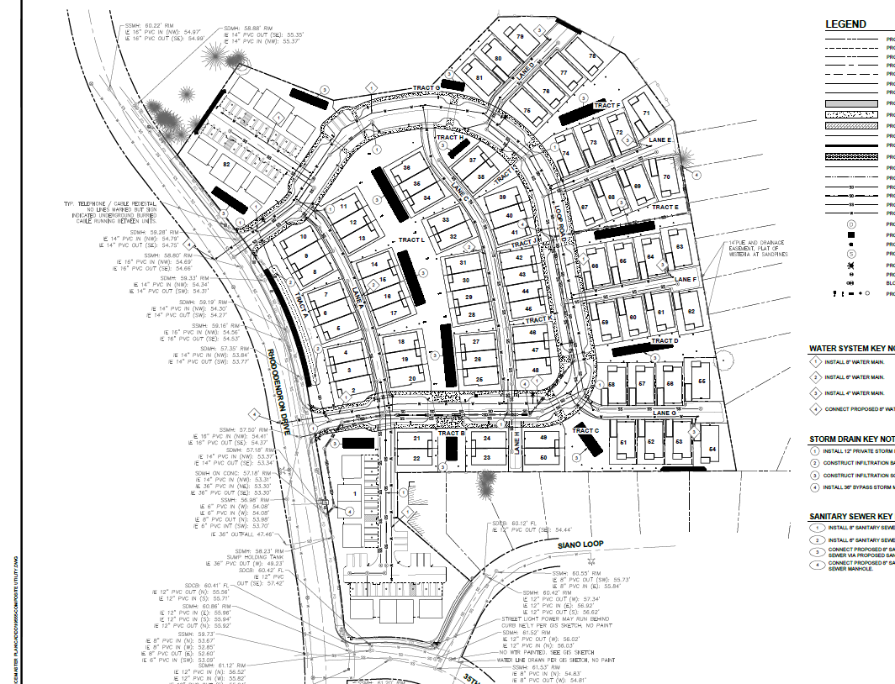
Conditions Review – Utilities & Stormwater

Slide 18
Conditions Review - Utilities
#13 ROW Construction Permit (Public Works)
#17 Coordinate w/City before Final Plan
#19 Provide blow-off/air release valve assembly at end of each H2O line (Lanes)
#20 Verify pre & post dev. main & fire flow
#20a Allocate no parking in fire lanes
#22 Review street & utilities plan w/Public Works

Slide 19

Conditions Review – Stormwater & Wetlands
#12 & 30 Phase 1 Site Investigation Report- if Phase II needed (CUP), hire qualifying hydrogeologist
#21 Permit from state to disturb soil over 1 acre
#3 Immediate contact w/ SHPO or CTCLUSI upon discovery of cultural or historic resources & cease construction.
#31 No water to leave site

Slide 20
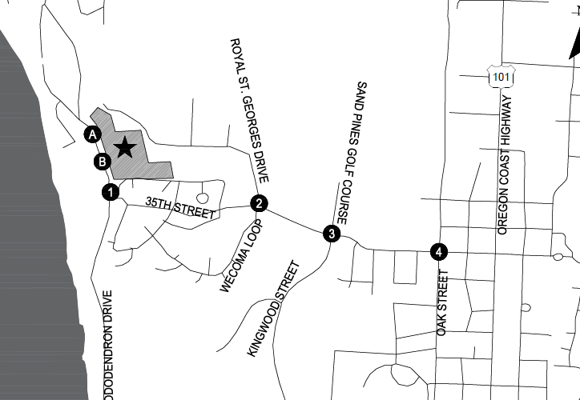
Conditions Review - TIA
#11 Update TIA prior to Phase 1B w/Final Plat application

Slide 21
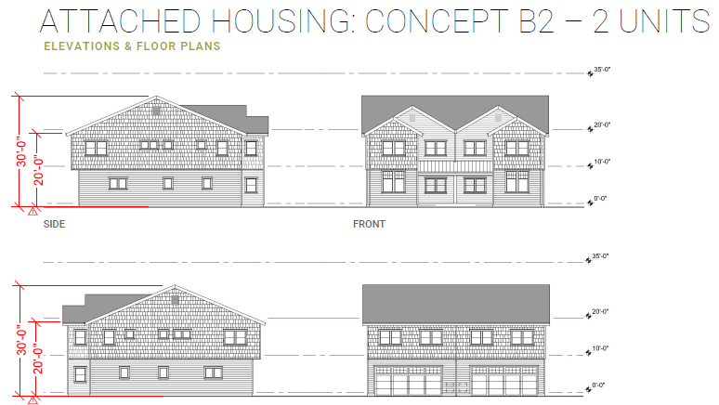
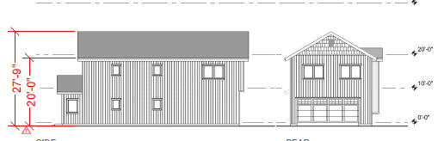
Conditions Review--Architectural
#7 Design Review for multi & attached housing
#8. Meet or Exceed Architectural Standards for Detached Single Family

Slide 22
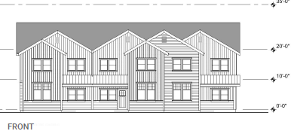
Conditions Review--Architectural
#10 Label and Dimension Porch areas for Final PUD

Slide 23
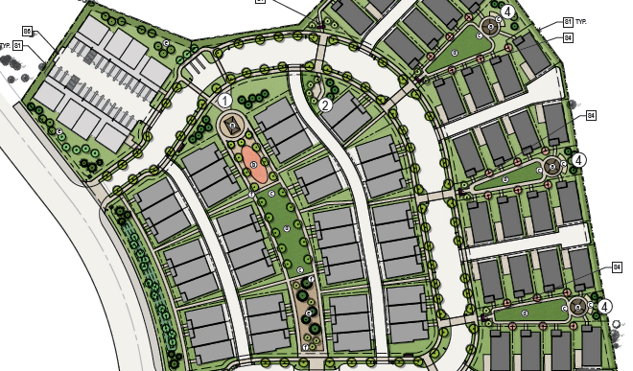
Conditions Review—Open & Recreation Space
#13a. Demonstrate additional open space and rec space uses w. Final PUD application
#26. Submit new Landscape plans – different functions, street trees, stormwater…
#27. Submit irrigation plan

Slide 24
Conditions Review—Bicycle Parking
#4. Dimensioned Parking Plan w/ final PUD
#6. Bike Parking Signage Plan prior to permitting

Slide 25
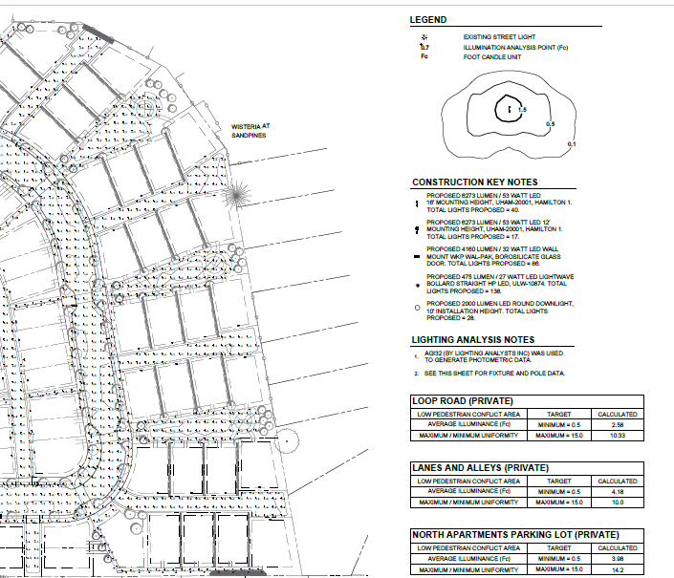
Conditions Review--Lighting
#23. Revised Photometric Plan (Final PUD/Design Review) Except SF Detached- those at permitting…
#24. Revise candle sizes over parking and light fixtures
#25 Mounting -No more than 20’ high

Slide 26
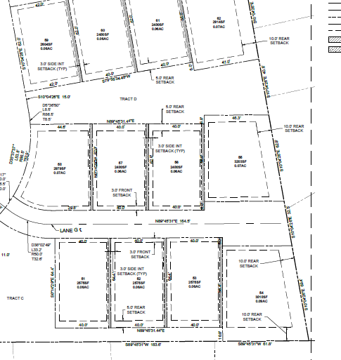
Conditions Review—Platting etc.
#5 Maintenance Easements, CC&Rs
#16 Notations/Label for Ownership & Conveyance
#18 Label curb radii
#28 Loop Dr. & Final Plat Name?
#29 Provide Affidavit of Services
#33 Label correct setbacks- side v. rear.

Slide 27
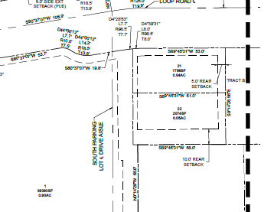
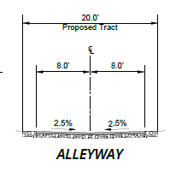
Conditions Review—Platting etc.
#14. Lot 22 not Lot unless Tract is labeled.
#14a. Re-label cross section to “Proposed ROW” and “Tract”
#15 Correct Rhody cross section

Slide 28
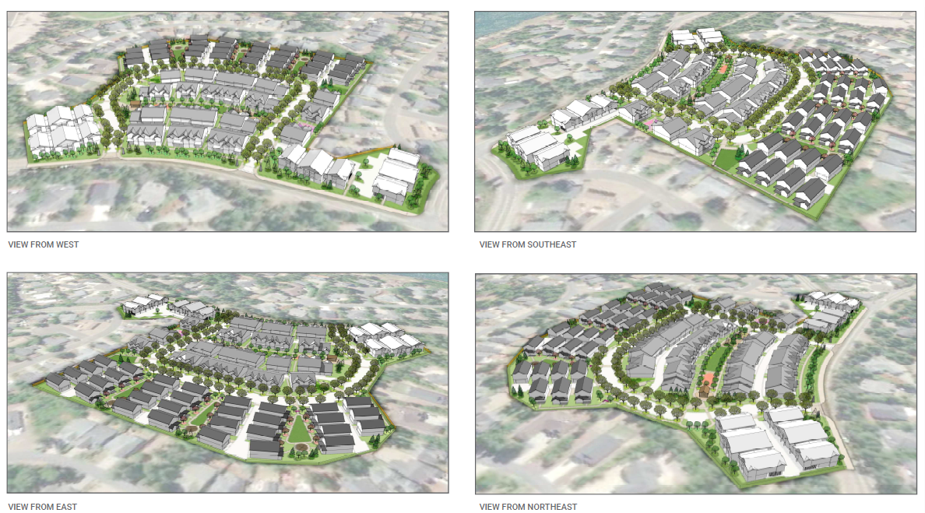
Conditions Review--General
#1 Mods to approved plan require additional approval
#2 Agreement of Acceptance
#5 Easement & Acceptance Plans for CC&Rs
#8a Record Covenant of Release prior to permitting/Final Plat
#9 Draft maintenance easements for Final PUD approval

