Slide 1
La Mota
Conditional Use Permit w/ Design Review for
La Mota Marijuana Retailer
PC 19 26 CUP 09

Slide 2
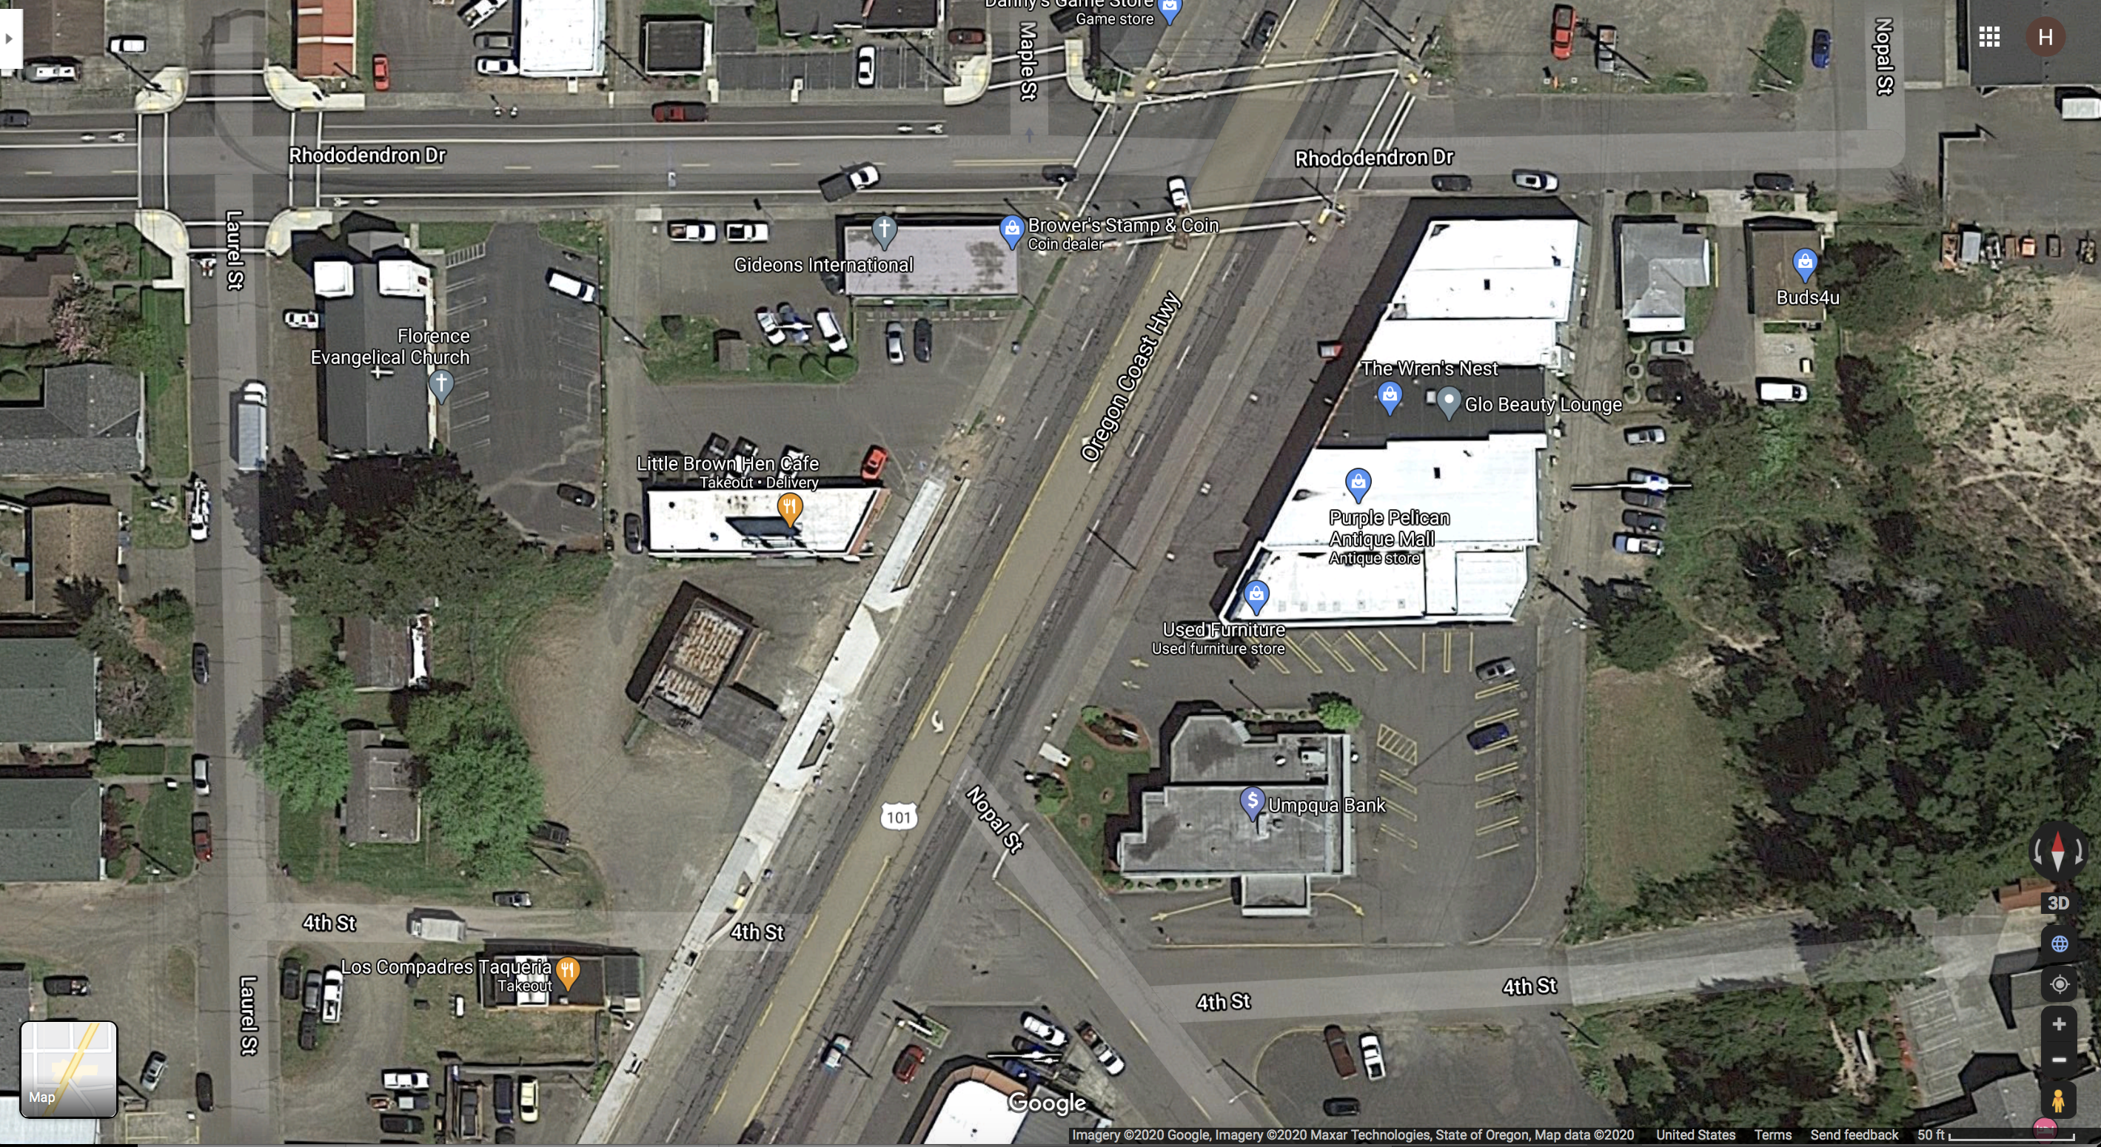
Aerial of Site

Slide 3
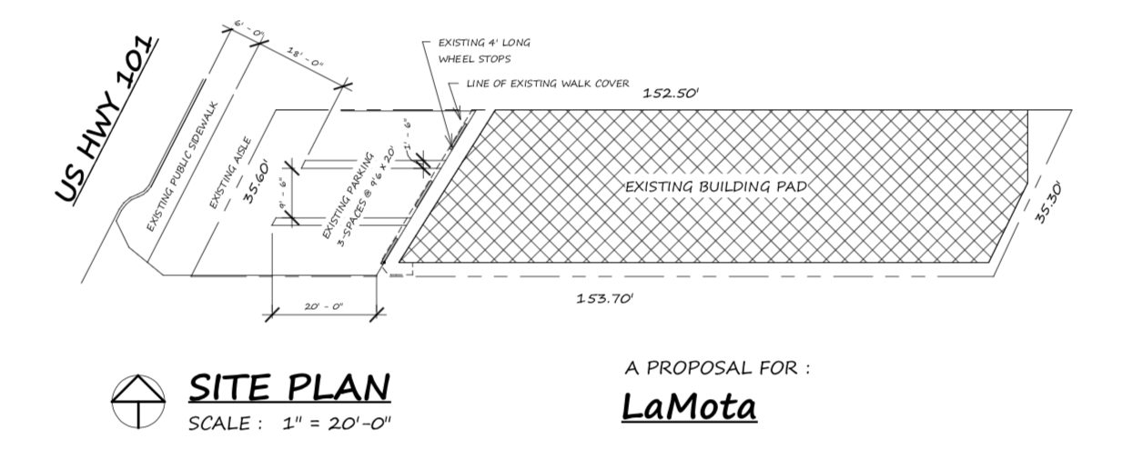
Site Plan

Slide 4
Testimony
Testimony in Opposition: the respondents comments are regarding: (1) lack of parking in the mall complex and the applicant’s inability to meet the parking requirements of FCC 10-3 Parking, (2) congestion in and around the mall (FCC 10-35 Access and Circulation), and (3) the use of the space for marijuana retail (clientele, proximity to residential uses, character of the downtown corridor).
Testimony in Favor: the respondents are in favor of the development in general.

Slide 5
Conditions of Approval
Access & Circulation:
12. The applicant shall submit a site circulation plan, meeting the requirements of 10-35 Access and Circulation.
Edit: Remove Condition 13 for redundancy:
13. The applicant shall either (a) record with the deed to Subject Property and easement, allowing access to Subject Property from Rhododendron Ave, across lots 12200, 12201, 12100, 12000, 11900 (the mall), and 11700 (the bank), or (b) submit to the City a ruling stating Subject Property has a right to access through those lots.

Slide 6
Conditions of Approval
Parking:
10. The applicant shall submit a parking plan, meeting the standards of FCC 10-3 Parking & Loading, including but not limited to providing 8 parking spaces one of which shall be an ADA space, sized and striped in accordance with code, and bicycle parking.
11. The parking stalls on Subject Property shall be re-striped, and meet the requirements of 10-3-9 Parking Stall Design and Minimum Dimensions.

Slide 7
Conditions of Approval
Security:
6. The applicant shall install and position security cameras in such a way as to only show the licensee’s property and surrounding public right-of-way.
15. The applicant shall submit a lighting plan, meeting the requirements of FCC 10-37 Lighting.

Slide 8
Conditions of Approval
Smells:
4. The applicant shall submit to the City Community Development Department documentation showing the air circulation system in the building is not connected to any other building in the mall prior to commencing business.
5. The applicant shall submit to the City Community Development Department documentation showing an effective odor control system in the building prior to commencing business.

Slide 9
Conditions of Approval
Appearance:
8. Any sign placed on Subject Property shall meet the requirements of Title 4 Chapter 7.
14. The applicant shall submit a landscaping plan, demonstrating compliance with FCC 10-34 Landscaping and 10-27-5: Site and Development Provisions, L. Fences, Hedges, Walls and Landscaping. This plan shall include a minimum of 10% landscaping on Subject Property. This may include the street trees planted along the sidewalk, installed via ReVision Florence, planter boxes, trellises, and courtyard areas.

Slide 10
Staff Recommendation
Staff finds that the proposed application meets the requirements of City Code with conditions, and recommends approval of the Conditional Use Permit, subject to conditions.

Slide 11
Alternatives
Approve the applications;
Deny the application;
Modify the findings, reasons, or conditions and approve the proposal, or
Continue the Public Hearing to a date certain if requested or if more information is needed.

Slide 12
Questions?

