Slide 1
Siuslaw Estuary Trail
Design Review
. . .
Resolution PC 24 03 CUP 03

Slide 2
Introduction / Timeline
Feb 7
Property Posted NOH Mailed
April 15
CC meeting – funding Approval
Jan 24
App & Payment Received
Feb 21
SNEWS Notice Published
2013
Siuslaw Estuary Trail Vision Approved
Feb 27:
Public Hearing
Jan 30
Additional Items Received & App Deemed Complete
Proposal: Multi-Use trail, public parking lot, sidewalk, and associated amenities.

Slide 3
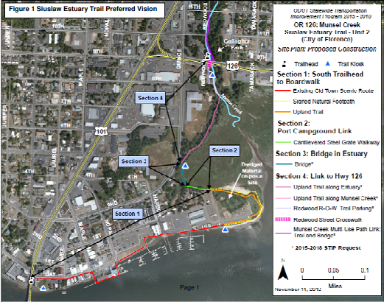
Estuary Trail Vision

Slide 4
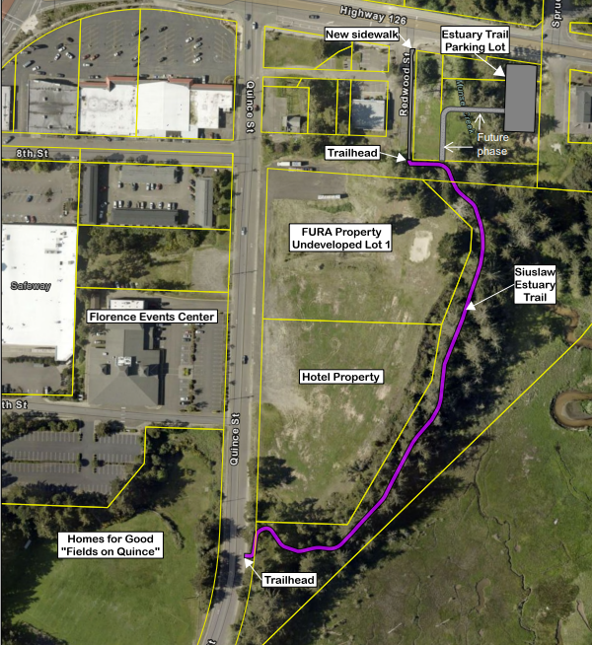

Aerial of Site
N

Slide 5
Review Criteria: City Code
Title 10: Zoning Regulations:
Chapter 1: Zoning Admin., Section 1-6-3
Chapter 2: General Provisions, Sections 12 C & E4, and 13
Chapter 3: Off-Street Parking, Sections 2 to 5, 8-C to L, 9, & 10
Chapter 7: Special Dev. Standards, Sections 2 through 7
Chapter 17: Old Town Districts, Sections 17C-2-A, 17C-4-C to K, Fig.17.2
Chapter 19: Estuary, Shorelands and Beaches.., Sections 1, 2, and 10
Chapter 27: Mainstreet Areas, Sections 2 though 5
Chapter 34: Landscaping, Section 2, 3 and 4
Chapter 35: Access and Circulation, Sections 2 and 3
Chapter 36: Public Facilities, Sections 2-1, 2-5, 2-11, 2-16 to 2-21, 2-23, 5 & 9
Chapter 37: Lighting, Sections 2 through 4

Slide 6
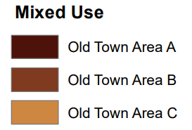
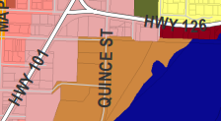
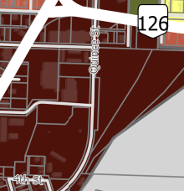
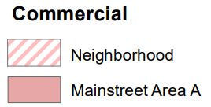
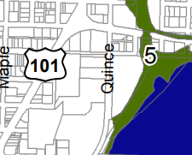



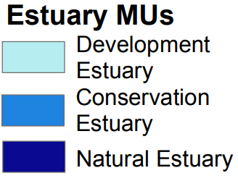
Zoning & Comp Plan Maps
Zoning Map
Comp Plan Map
Estuary & Coastal Shorelands MU Map
Notes:
Area Shall Include high-quality &durable amenities.
FCC 10-1-4?? Burden of evidence

Slide 7
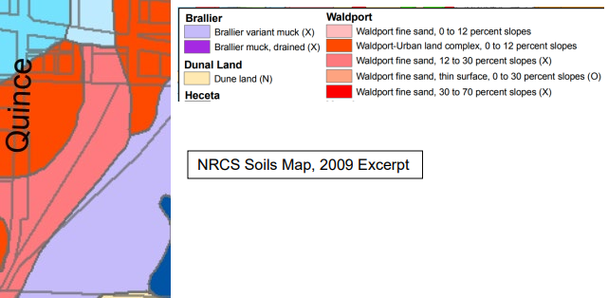
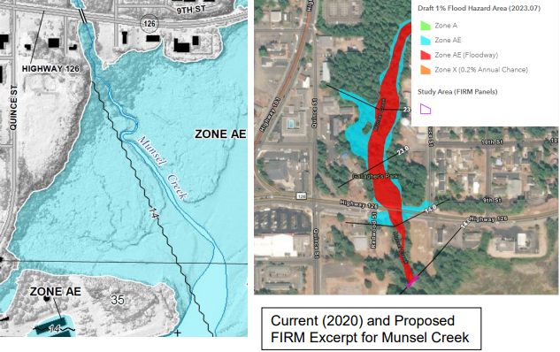
Soils & Flood Maps

Slide 8
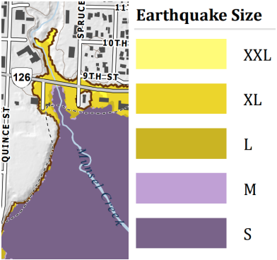
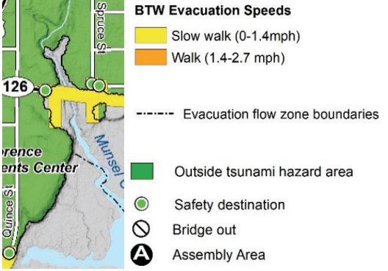
Tsunami & Earthquake Maps

Slide 9
Review Criteria: Comp Plan
Realization 202 Florence Comprehensive Plan
Chapter 2: | Land Use | Policy 1
 | Other Plan Designations | Policy 1
 | Other Plan Designation Categories | Downtown
Chapter 5: | Open Spaces and Scenic, Historic, and Natural Resources
 | Scenic Resources & Visual Quality | Policies 1 and 3
Chapter 8: | Parks and Recreation | Policies 6, 9, and 11c
 | Open Space | Policies 13 to 15 and 19 Recommendations 7 to 9
Chapter 12: | Transportation | Policies 8, 13, 15 to 19, 22, 23, 34, 35, 40, 41, and 44
Chapter 13: | Energy Facilities & Conservation | Policies 1 and 2
Chapter 16: | Estuarine Resources | Policies 15 and 16
Chapter 17: | Coastal Shorelands | Policies 5, 12, and 14 Management Unit #5

Slide 10
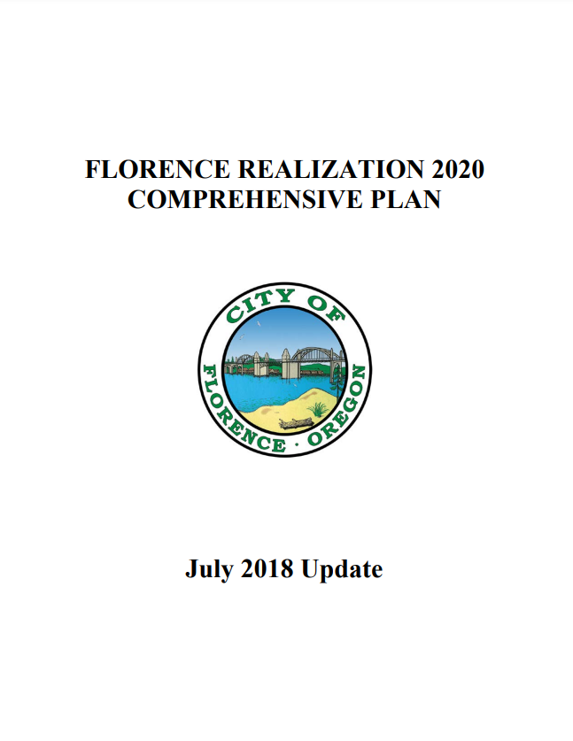
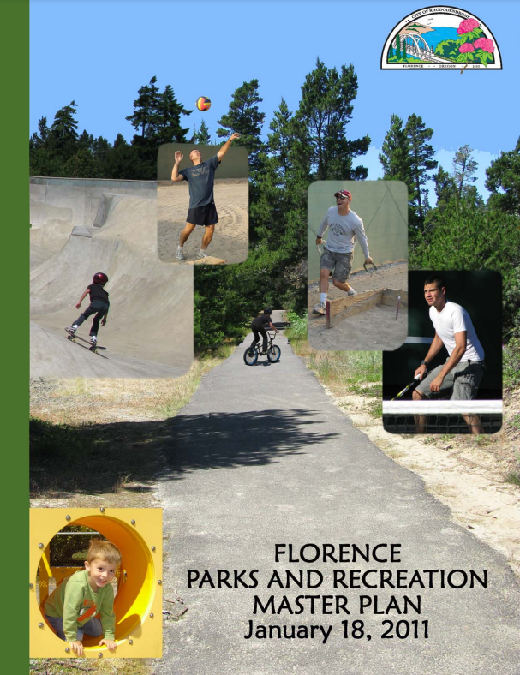

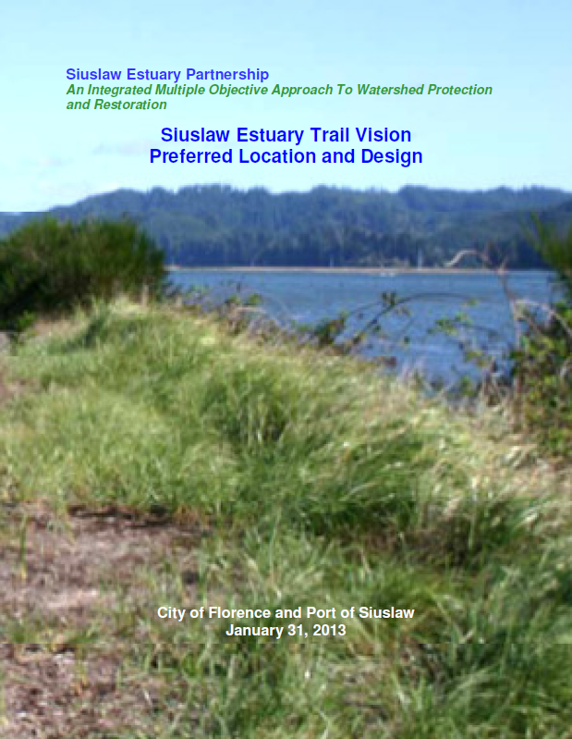
Adopted & Approved Plans
Notes:
Area Shall Include high-quality &durable amenities.
FCC 10-1-4?? Burden of evidence

Slide 11
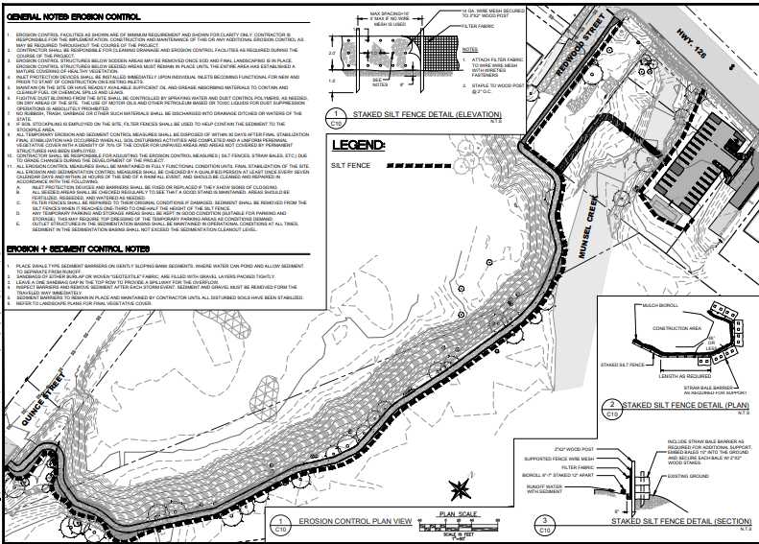
Site Plan

Slide 12
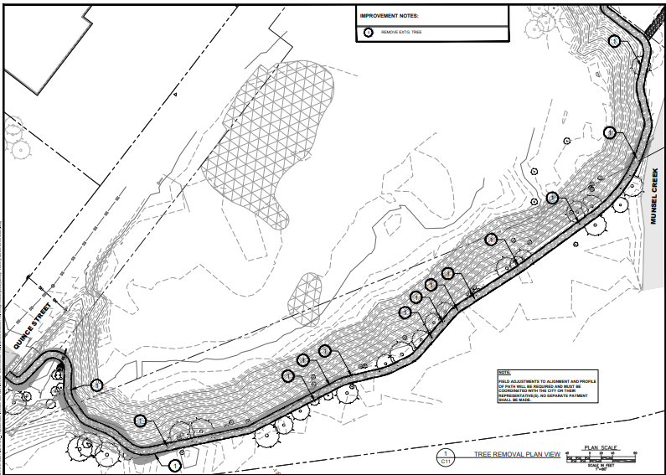
Trail Plan

Slide 13
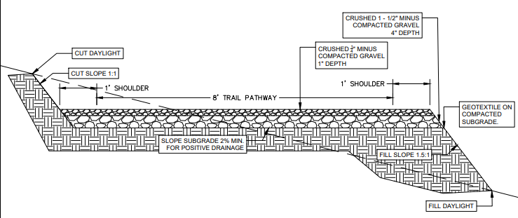
Trail Cross Section

Slide 14
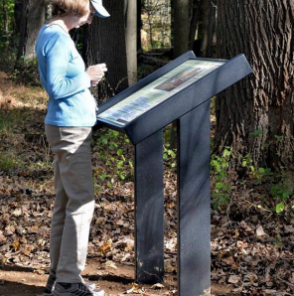


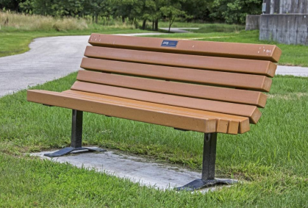
Trail Amenities

Slide 15
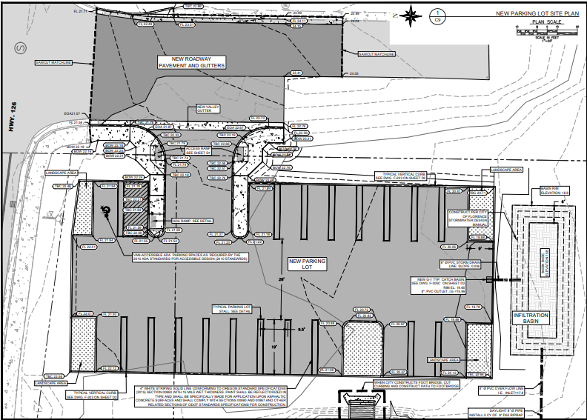
Parking Lot Plan
N
Notes:
Exhibit E – Sheets L1 and L2
Exhibit C – Civil Plans Sheet C2 snip included
Sheet G11 included

Slide 16
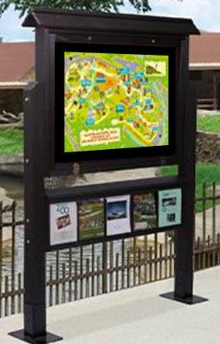
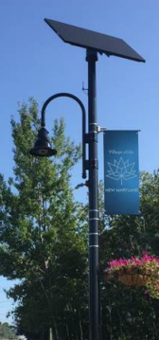
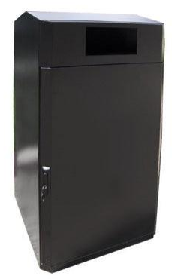

Parking Lot Amenities

Slide 17
Conditions of Approval
CTCLUSI to be contacted upon encountering any cultural or historical resources
5 foot wide landscape area provided wherever parking lot abuts street ROW
All parking lot striping shall meet FCC 10-3-9-B
Relocation of bike rack outside landscape area
Proposed bicycle parking signage shall be submitted for review
Project signage shall include tsunami evacuation information

Slide 18
Conditions of Approval
Requires 3 activities to meet NRC management
  Cut & limits/boundaries to be flagged & photographed
  All veg. removal to be replanted with like vegetation
  Color, hue, & texture of benches and signage to blend with surrounding veg.
Illustrate on a contour map the location of MHT where point is more that 15 ‘ from project site prior to site disturbance
All newly installed sidewalks shall be 8’ wide
Parking lot lights shall be maximum 16’ in height
Landscape plans required for parking lot – submitted for PC review
Required landscaping areas adjacent to Spruce St and Hwy 126 shall have evergreen screening of decorative wall min 36’’ in height for screening

Slide 19
Condition of Approval
Parking lot driveway shall be a min. 50’ from Hwy 126
“No Parking” signage required along Redwood ROW.
Street lighting or pedestrian scale lighting at trail access if none exists.
Parking area shall have min 2 foot candles and max 5 foot candles. Photometric plan shall be submitted for PC review & approval.
2nd pet waste station shall be placed near Quince St, trailhead & include education on threat of dog waste on the estuary.
Submit revised Sheet C10/Exhibit E that includes pet waste stations at Redwood St & Quince St trailhead for consistency with Project proposal.
Area of disturbance in trail area shall be replanted with species native to estuary resource.

Slide 20
Issues & Decision Points
Application File number PC 24 03 CUP 03:
CUP – Conditional Use Permits
Estuary Trail is a permitted use in OTC and Shoreland MU
Public Parking is a permitted use in MSA
Staff recommends PC approve change in file #
Referral Notices:
Referral sent to CTCLUSI 2/21/2024
Staff recommends continuing PH or keeping record open
Provide CTCLUSI with additional time for project review

Slide 21
Alternatives
Approve the Design Review Permit with conditions of approval and findings of fact as written;
Review and recommend changes to the Design Review Permit findings and approve as amended;
Continue the Public Hearing to a date certain if more information is required; or
Do not approve the request, revising the findings and drafting a resolution stating how the application does not meet the criteria.

Slide 22
Staff Recommendation
Alternative 3, Continue the Public Hearing to a date certain if more information is required; or
* This is to provide increased time for CTCLUSI review and comment

Slide 23
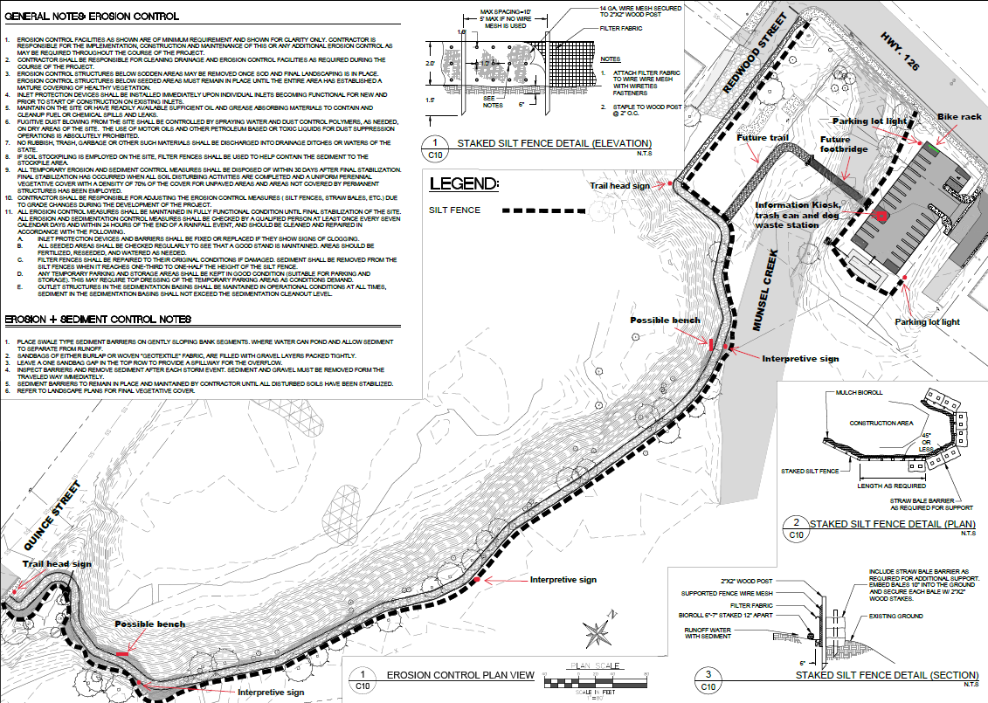
Questions?

